Slide 1
BAR1143: Assistive Resources for Learners with Visual Difficulties
Unit 1: Introduction to assistive resources
By a Team of UR-CE Lecturers

Slide 2
Unit 1: Introduction to assistive resources
Unit 1 learning outcomes
By the end of this unit, you should be able to:
- Explain background of assistive resources/resources
- Justify the usage of assistive resources

Slide 3
Unit 1: Introduction to assistive resources
Unit 1 indicative content
Topics in this unit:
Topic 1.1: Background of assistive resources
Topic 1.2: Importance of assistive resources

Slide 4
Topic 1.1: Background of assistive resources
 Activity 1 Kiza was born in a family of 5 children, he acquired visual difficulties when he was in primary 4. Before acquiring visual difficulties Kiza had been performing well academically at the end of the year Kiza was not promoted to the next class because he had failed in the examination, he was forced to repeat class four and he was given a tape recorder and Braille machine these two assistive resources helped him to improve his performance at the end of primary six he sat the national examination and passed well. Q.1 .What lead to Kiza’s poor performance in class? Q.2. When did Kiza acquired visual difficulties? Q.3. What do you think contributed to Kiza’s poor academic performance in class?

Slide 5
Topic 1.1: Background of assistive resources
Assistive resources is an umbrella term covering the systems and services related to the delivery of assistive products and services.
It is also the key to making educational environments inclusive.
Assistive Resource is any item, piece of equipment, software, device or product system that is used to increase learning, communication and maintain or improve the functional capabilities of individuals with disabilities.
It can be as high-tech as a computer or as low-tech as working with stick (UKEssays, 2018).
According to Kumar and Raja (2010) any equipment that is used to improve functional capabilities of individuals with disabilities is considered as AT.
It may include any software program or product system that is used to increase, maintain, or improve the functional capabilities of people with disabilities.

Slide 6
Topic 1.2: Importance of assistive resources
Activity 2
Q1. Mention any 2 types of Assistive resources and identify two materials found in each type of Assistive resources?
Q2. Why do you think that assistive technologies are necessary for persons with visual difficulties?

Slide 7
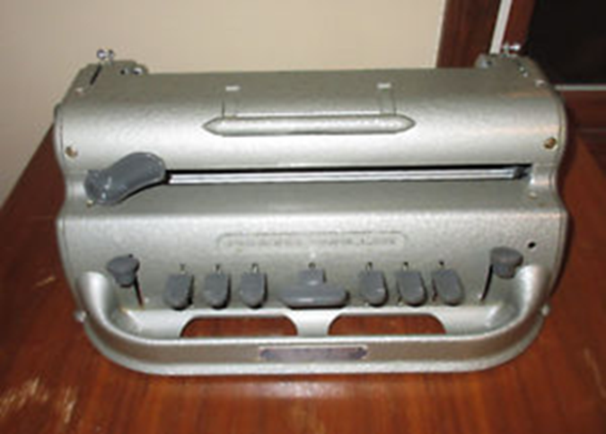
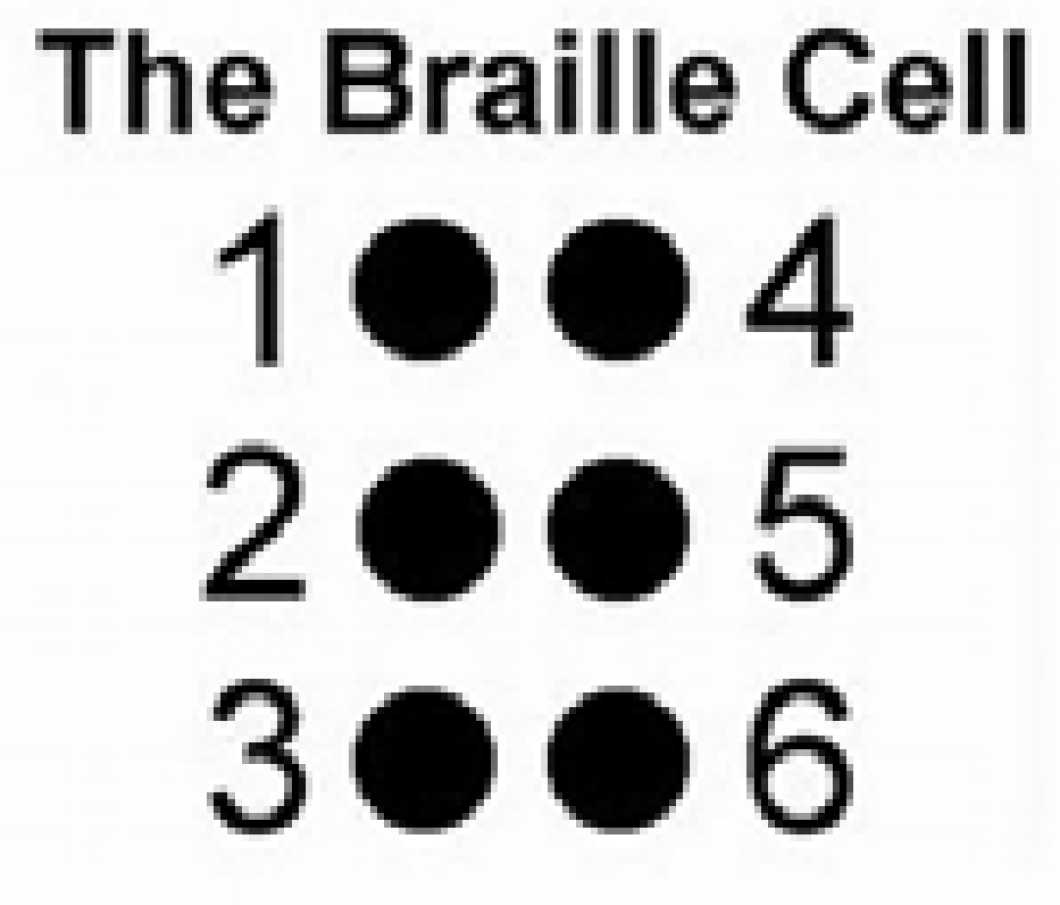
Assistive resources: Perkins Braille
Braille is a system of raised dots that can be read with the fingers by people who are blind or who have low vision. Dots are arranged in two vertical rows of three dots each (Howse, 2013).

Slide 8
Assistive resources
:Braille embossers
Basic-D V5
Braille embossers print a Braille version of the text.
Connected to a computer and used in conjunction with Braille translation software

Slide 9
Importance of AT
The following are the importance of assistive technologies:
• Assistive resources helps schools and teachers deliver on the promise of educational equity
• Assistive resources also enables people with visual impairments to be more independent
• People with low vision can also benefit from devices that magnify or enlarge objects
• Engages students and creates active learning
• Encourages individual learning and growth for students of all learning styles at their own pace
• Facilitates peer collaboration
• Prepares students for the real world
• Access to the most up-to-date information
• Makes learning fun

Slide 10
Unit 1: Introduction to assistive resources
Learning outcomes
By the end of this unit, you should be able to:
- Explain different types of assistive resources
- Identify appropriate assistive resources for learners with visual difficulties

Slide 11
Unit 1: Introduction to assistive resources
Topics in this unit:
Topic 2.1: Tactile Assistive Resources
Topic 2.2: Audio Assistive Resources
Topic 2.3: Visual Assistive Resources
Topic 2.4: Making, Using and Safe Keeping of Assistive Resources

Slide 12
Topic 2.1: Tactile Assistive Resources
Activity 5
Make a list of assistive resources which you think would be categorized as ‘tactile’.

Slide 13
Topic 2.1: Tactile Assistive Resources
The most important tactile resource for people with visual difficulties is braille. Some tactile resources are manufactured and can be purchased on the market. These include, for example:
• Braille compasses, Braille watches, The abacus,
• Signature guide,
• Slate and stylus,
• Brailler,
• Braille embossers,
• Refreshable Braille displays used alone or with computers,
• Braille note-takers.
Other tactile materials can be made by the teacher or the parent of a child with visual impairment.

Slide 14
Topic 2.2: Audio Assistive Resources
Individuals who are blind or have low vision need to maximize the use of their hearing sense.
They may include a friend reading printed matter to a visually impaired person, a hired reader, or the use of technology such as tape recorders, compact disks, or specialized computer software.
A lot of computer software has been developed to convert print into speech.
There are also applications used in mobile phones to do the same task. The use of synthetic speech has resulted in many useful assistive resources that use sound.
For example, there are talking calculators, talking weighing scales, talking watches, and so on. Books and other materials can be recorded and stored in a variety of formats for later playback.

Slide 15
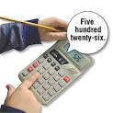
Topic 2.2: Audio Assistive Resources
Uses a built-in speech synthesizer to speak number, symbol or operation keys as they are pressed.
They also read back answers from completed calculations

Slide 16
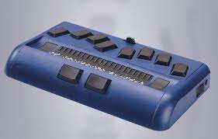
Topic 2.2: Audio Assistive Resources
Below is a list of common assistive resources used by learners with visual difficulties described by ACO Staff Writers (2021).
Braille displays: This device displays information on a computer screen by raising and lower combinations of braille pins.
Braille printers: Also known as “braille embossers,” these printers translate print text in Braille format onto specialized paper.

Slide 17
Topic 2.2: Audio Assistive Resources
Below is a list of common assistive resources used by learners with visual difficulties described by ACO Staff Writers (2021).
3. Braille translators
This device convert information from a document and translates it into a Braille file. That information can then be read on a Braille display, a personal assistant device, or sent to a Braille embosser.
4. Personal data assistant
Also known as “Braille note takers,” personal data assistants are small, portable devices that can be used with Braille or typewriter keywords.

Slide 18
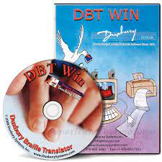
Topic 2.2: Audio Assistive Resources
Below is a list of common assistive resources used by learners with visual difficulties described by ACO Staff Writers (2021).
3. Braille translators
This device convert information from a document and translates it into a Braille file. That information can then be read on a Braille display, a personal assistant device, or sent to a Braille embosser.
4. Personal data assistant
Also known as “Braille note takers,” personal data assistants are small, portable devices that can be used with Braille or typewriter keywords.

Slide 19
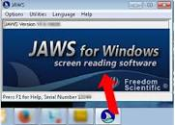
Topic 2.2: Audio Assistive Resources
5. Screen readers
Screen Readers are software programs that interface with the computer’s operating system and provides the user full control over reading and interacting with their computer (e.g. using a navigation menu, highlighting text, using a spell checker, etc.). Example: Job Access with Speech (JAWS)
It is arguably the most widely used screen-reading program.
7. Screen magnification
Screen Magnification Systems allow the user to enlarge the graphic, media, and text on a computer screen.

Slide 20
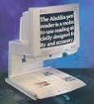
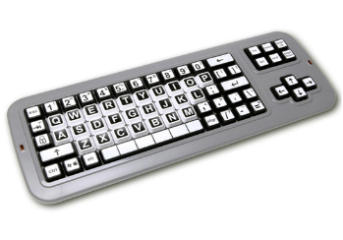
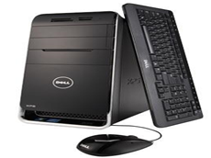
Topic 2.2: Audio Assistive Resources
8. Video magnifiers/CCTV
Also known as a closed-circuit television system, video magnifiers use stand-alone cameras to project magnified images onto a television screen, computer monitor, or video monitor.
9. Large-print key board
Large-Print Keyboards are key boards with larger keys and color displays that are easier to see.
10. Text to speech software
Text-to-speech software turns electronic text into audible speech for low vision or blind users

