Slide 1
training on Microsoft certified educator.
Course i: 21st learning design

Slide 2
INTRODUCTION
Educators globally are working to design new models of learning that better prepare learners. The purpose of this guide is to help educators identify and understand the 21st century skills that are demonstrated in students’ work products.
Student work is what students produce when they complete a learning activity. It can be something they completed in one class period or the results of an extended project that took place both in and outside of school.

Slide 3
CONT…
This guide describes six dimensions of students’ 21st century learning, each of which represents an important skill for students for develop:
• collaboration
• skilled communication
• knowledge construction
• self-regulation
• real-world problem-solving and innovation
• use of ICT for learning

Slide 4
CONT…
For each dimension, this guide will help you to determine how strongly the student work demonstrates the related skill. Each dimension has the same structure:
• The overview introduces key concepts for that dimension.
• The “big ideas” define important attributes of the student work for each dimension.
• The rubric uses the big ideas to help you assign a number (Code) from 1 to 4, or I to 5, according to how strongly the student work demonstrates the given skill.
• The flowchart shows how to choose the best number in each case.

Slide 5

Module I .
Collaboration

Slide 6
Introduction
This unit explores the broader meaning of collaboration, and your understanding of it. In today’s workplace young people are expected to collaborate and this rubric helps you to understand what we mean by collaboration. It helps you to design lessons where students can develop collaboration skills. It will also introduce you to the dimensions of collaboration which are: students working in groups or pairs, sharing responsibility, making substantive decisions together, and being co-dependent on one another.

Slide 7




BIG IDEAS of collaboration

Slide 8
BIG IDEA ONE: WORKING TOGETHER.
What does working together mean?

Slide 9
BIG IDEA ONE: WORKING TOGETHER.
Students are working together when they work in pairs or groups to:
• discuss an issue
• solve a problem
• create a product

Slide 10
CONT…
Students’ work in pairs or groups might also include people from outside the classroom, such as students in other classes or schools, or community members or experts. Students can work together face to face or by using technology to share ideas or resources.

Slide 11
CONT…
    What kind of technologies students can use to work together? (brainstorm)

Slide 12

Example.
Is this working together? | Yes | No
Pairs of students gave each other feedback.
Students did their work alone.
A small group discussed an issue together.
The whole class discussed an issue.
A student used Skype to interview a student in another town.
Students used OneNote to share their story drafts and give each other feedback.
Each student created his/her own story and sent it to the teacher for feedback.

Slide 13
Example.
Is this working together? | Yes | No
Pairs of students gave each other feedback. | X
Students did their work alone. |  | X
A small group discussed an issue together. | X
The whole class discussed an issue. |  | X
A student used Skype to interview a student in another town. | X
Students used OneNote to share their story drafts and give each other feedback. | X
Each student created his/her own story and sent it to the teacher for feedback. |  | X

Slide 14
BIG IDEA TWO: SHARING RESPONSIBILITIES
What does sharing responsibility mean?

Slide 15

CONT…
Students are sharing responsibility when they are working in pairs or groups to develop a common product, design, or response. Shared responsibility is more than simply helping each other: students must collectively own the work and be mutually responsible for its outcome.
If the group work involves students or adults from outside the classroom, this qualifies as shared responsibility ONLY if the students and the outside participants are mutually responsible for the outcome of the work.

Slide 16

EXAMPLE.
IS THIS A SHARED RESPONSIBILITY? Why | Yes | No
Students conducted a lab experiment together.
A student worked with a peer in another country via Skype and Microsoft Office 365 to develop a joint website.
Students gave each other feedback.
A student interviewed a peer in another country via Skype about the local weather.

Slide 17
EXAMPLE.
IS THIS A SHARED RESPONSIBILITY? Why | Yes | No
Students conducted a lab experiment together. | Students had joint responsibility for carrying out the lab experiment.
A student worked with a peer in another country via Skype and Microsoft Office 365 to develop a joint website. | The students shared responsibility for the development of the website.
Students gave each other feedback. |  | One student “owned” the work, and the other was only helping.
A student interviewed a peer in another country via Skype about the local weather. |  | This is a task that students conducted together, but they did not have mutual responsibility for any particular outcome.

Slide 18
CONT…
Students are sharing responsibility fairly when all students on a team are engaged in the work, and all are contributing toward the final outcome. If the task gives students shared responsibility but in practice one student is doing all or most of the work, they are not sharing the responsibility fairly.

Slide 19

EXAMPLE.
ARE STUDENTS SHARING RESPONSIBILITY FAIRLY? | Yes | No
A team of 4 students designed a website about an author. Two students divided the topics and did most of the website creation, while the other two students were talking about something else.
A team of 4 students designed a website about an author. Each of the students contributed the text and visuals related to a different book the author had written.

Slide 20
BIG IDEA 3: SUBSTANTIVE DECISIONS
What does making substantive decisions mean?

Slide 21
CONT…
Students are making substantive decisions when they are actively resolving important issues that will guide their work. Substantive decisions are decisions that shape the content, process, OR product of students’ work:
Content: Students are using their knowledge of an issue to make a decision that affects the academic content of their work together, such as taking a stance on a topic they will then write about, or deciding on the hypothesis they will test.
Process: Students are planning what they will do, when to do it, what tools they will use, or the roles and responsibilities of people on the team.
Product: Students are making fundamental design decisions that affect the nature and usability of their product.

Slide 22
example
DID THESE STUDENTS MAKE SUBSTANTIVE DECISIONS?
Students discussed which capital city to choose for their project, based on what they knew of the political systems of each country. The students negotiated their ideas.
  Yes. This is a content decision that will shape their work together.

Slide 23
example
Students worked together to identify capital cities of particular countries in Europe.
  No. This decision does not affect the rest of their work.

Slide 24
example
Students devised a plan for creating their music video for international children’s day. Students discussed who would direct, shoot, and edit the video; what technologies they would use; and the timeline for completing different stages of the work.
  Yes. These decisions are fundamental to the work process for the entire project.

Slide 25
example
Students filmed a video according to the list of steps the teacher provided.
  No. The teacher planned the process of their work, not the students.

Slide 26

CONT…
Students are making substantive decisions together when they interact with one another to jointly arrive at their decision. During this process, students can usually be observed to be sharing ideas, listening to each other, and negotiating and debating if they do not initially agree. They might also decide on a strategy for coming to agreement: they have to convince each other, or they will take a vote and go with the majority opinion, for example.
If students have different opinions and one of the students makes the decision for the entire group without taking the opinions of other students into account, this is NOT considered making substantive decisions together.

Slide 27
DID STUDENTS MAKE SUBSTANTIVE DECISIONS TOGETHER?
A group of students planned how they would conduct the interviews for their oral history project: some students wanted to create a specific protocol to follow, while others wanted to conduct more open-ended interviews. Eventually they decided to create a list of topics to use as a guide, while letting the interviews mostly follow their own course.
  Yes. This is a substantive decision about their work process, and students arrived at a middle-ground solution to their initial question.
Students decided whether to create an online journal or a physical journal for their next journalism class project. Some students preferred one option, while others preferred the other. One student told the teacher they couldn’t decide and asked the teacher to decide for them.
  Students did not make the decision together and did not have a strategy to resolve their disagreement themselves.

Slide 28
BID IDEA 4: INTERDEPENDENT.
What does inter-dependent work mean?

Slide 29
CONT…
Students’ work is interdependent when all students must participate in order for the team to succeed. Too often, a group of students may share responsibility for an outcome, but in practice the work is not divided fairly: one or two students may do all the work for the team. The strongest learning activities on this rubric are structured to require the participation of all students.

Slide 30

CONT…
Students’ work is interdependent when all students must participate in order for the team to succeed. Too often, a group of students may share responsibility for an outcome, but in practice the work is not divided fairly: one or two students may do all the work for the team. The strongest learning activities on this rubric are structured to require the participation of all students.
To meet this criterion, students must be required to produce an interdependent product (such as a presentation that they each must share in developing and presenting) or other interdependent outcome (such as a decision that requires information that is distributed across students).

Slide 31
Cont…
Most interdependent work involves two levels of accountability:
Individual accountability: each individual on the team is responsible for a task that he or she must complete in order for the group to do its work. The role of each student on the team is essential.
Group accountability: the students must work together to produce the final product or outcome. Students must negotiate and agree on the process, design, and conclusions of their work.

Slide 32
Cont…
It is important that the work is structured in a way that requires students to plan together and take the work of all team members into account so that their product or outcome is complete and fits together. For example, if each student is responsible for a page of a presentation, and in the final presentation the pages are simply assembled together, this is NOT considered interdependent.
The final presentation IS considered interdependent if the students’ contributions must work together to tell a story or communicate an overarching idea; in this case, students’ individual pages must be designed as parts of a coherent whole.

Slide 33
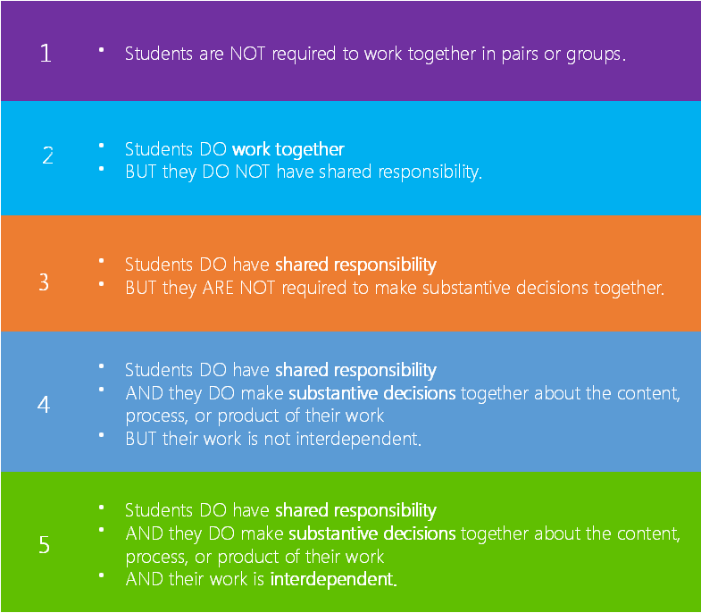
Rubric - Collaboration

Slide 34
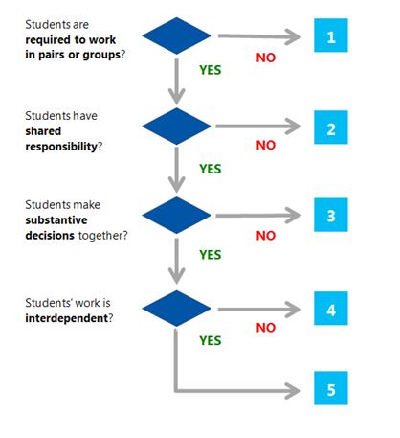
Decision Tree - Collaboration

Slide 35
Click here for Quiz

Slide 36
Education.Microsoft.com

Slide 37

Module ii:
SKILLED COMMUNICATION

Slide 38
INTRODUCTION
Skilled communication in the 21st century learning refers to the ability of individuals to communicate clearly, using oral, written, and non-verbal languages. Society now requires that everyone has these abilities, because the demands of social relations and the global economy call for a much more diverse set of communication skills. This unit introduces the concept of skilled communication and supports teachers to design learning activities where young people can develop this important skill.

Slide 39
INTRODUCTION
21st century communication can take many different forms. For example, as part their work students may have a discussion with a peer over Skype. In this rubric, we don’t focus on informal classroom talk, whether face-to-face or electronic. Instead, we focus on students’ articulation of their ideas in a permanent form: a presentation, a podcast, a written document, an email, etc. A performance (for example, a skit or oral debate) would also be considered in this rubric. We recognize that less formal conversational media are also very important aspects of communication. But effective uses of Skype will have an outcome related to the learning goals of the activity: did students produce a summary of what they learned through Skype, or build that learning into the final product they created? This rubric evaluates the skilled communication exhibited in the products or outcomes of the students’ work.

Slide 40
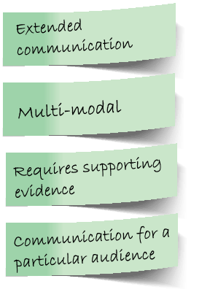
BIG IDEAS OF SKILLED COMMUNICATION

Slide 41
BIG IDEA 1: Extended communication
What does extended communication mean?

Slide 42
BIG IDEA 1: Extended communication
Extended communication is required when student must produce communication that represents a set of connected ideas, not a single simple thought.
In written work, extended communication is the equivalent of one or more complete paragraphs rather than a sentence or phrase.
In electronic or visual media, extended communication might take the form of a sequence of video, a podcast, or a page of a presentation that connects or illustrates several ideas.
A single text message or tweet is NOT extended communication. If students are engaged in electronic communication, this is ONLY considered extended communication if it produces an outcome that requires students to connect the ideas they discussed (for example, producing documentation of what they learned or next steps for resolving an issue that arose). The duration of an electronic chat is not considered in evaluating extended communication.

Slide 43
BIG IDEA 1: Extended communication
IS THIS EXTENDED COMMUNICATION? | Yes | No
A student wrote a paragraph in response to an essay prompt.
Students hosted a webinar to present on different topics about their city to peers in their sister-city and then answered follow-up questions.
Students participated in a webinar where they listened to presentations by peers from their sister-city and then asked follow-up questions.
Students held a Skype conversation with peers from another school to talk about the novel they read.
A student wrote an extended proof to demonstrate the solution to a geometry problem.

Slide 44
BIG IDEA 1: Extended communication
IS THIS EXTENDED COMMUNICATION? | Yes | No
A student wrote a paragraph in response to an essay prompt. | X
Students hosted a webinar to present on different topics about their city to peers in their sister-city and then answered follow-up questions. | X
Students participated in a webinar where they listened to presentations by peers from their sister-city and then asked follow-up questions. |  | X
Students held a Skype conversation with peers from another school to talk about the novel they read. |  | X
A student wrote an extended proof to demonstrate the solution to a geometry problem. | X

Slide 45
BIG IDEA I1: Multi-modal
What does multi-modal communication mean?

Slide 46
BIG IDEA I1: Multi-modal
Communication is multi-modal when it includes more than one type of communication mode or tool used to communicate a coherent message. For example, students might create a presentation that integrates video and text, or embed a photograph into a blog post. The communication is considered multi-modal only if the elements work together to produce a stronger message than any one element alone.

Slide 47
BIG IDEA I1: Multi-modal
If the learning activity offers students the opportunity to choose the tool or tools they will use to communicate, we consider it to be a multi-modal communication opportunity.

Slide 48
BIG IDEA I1: Multi-modal
IS THIS COMMUNICATION MULTI-MODAL? | Yes | No
A team of students created a radio advertisement for their new invention, choosing to use an audio rather than print medium because they thought it would be most compelling if they could use sound.
A team of students produced a podcast on a hurricane, and turned in a written script and the final audio podcast.
A student wrote a lab report about her science lab on density of matter, including only narrative text.

Slide 49
BIG IDEA I1: Multi-modal
IS THIS COMMUNICATION MULTI-MODAL? | Yes | No
A team of students created a radio advertisement for their new invention, choosing to use an audio rather than print medium because they thought it would be most compelling if they could use sound. The students chose what type of media would be best to use for the purpose. | X
A team of students produced a podcast on a hurricane, and turned in a written script and the final audio podcast. The story is the same whether written out (in the script) or spoken (in the podcast); multiple media were not used to enhance the content of the communication. |  | X
A student wrote a lab report about her science lab on density of matter, including only narrative text. The student used only one mode of media. |  | X

Slide 50
BIG IDEA I1I: Requires supporting evidence
What does supporting evidence mean?

Slide 51
BIG IDEA I1I: Requires supporting evidence
Communication requires supporting evidence when students must explain their ideas or support their thesis with facts or examples.
For this rubric, a “thesis” is a claim, hypothesis, or conclusion. Students must have a thesis when they are asked to state a point of view, make a prediction, or draw a conclusion from a set of facts or a chain of logic.
The communication requires evidence if students must describe their reasoning or provide supporting facts or examples. The evidence should be sufficient to support the claim that the student is making.

Slide 52
BIG IDEA I1I: Requires supporting evidence
DID THIS STUDENT PROVIDE SUFFICIENT SUPPORTING EVIDENCE? | Yes | No
Students used OneNote to create a video of themselves solving a mathematical problem.

Slide 53
BIG IDEA I1I: Requires supporting evidence
DID THIS STUDENT PROVIDE SUFFICIENT SUPPORTING EVIDENCE? | Yes | No
Students used OneNote to create a video of themselves solving a mathematical problem. | The video includes an explanation of the steps the student took and their reasoning. The video provides an explanation of both the process and the rationale, enabling the viewer to follow the student’s thought process. | The video only includes the steps the student took to solve the problem, without any explanation of their reasoning. The video does not provide sufficient evidence to explain the student’s thinking.

Slide 54
BIG IDEA IV: Communication designed for a particular audience
Students are required to design their communication for a particular audience when they must ensure that their communication is appropriate to the specific readers, listeners, viewers, or others with whom they are communicating. It is not sufficient for students to be communicating to a general audience on the internet. They must have in mind a specific group with specific needs in order to shape their communication appropriately.

Slide 55
BIG IDEA IV: Communication designed for a particular audience
DID STUDENTS DESIGN THEIR COMMUNICATION APPROPRIATELY FOR A PARTICULAR AUDIENCE?
ACTIVITY | Yes | No
Students wrote emails to a product manager of a company, suggesting improvements to a product.

Slide 56
BIG IDEA IV: Communication designed for a particular audience
DID STUDENTS DESIGN THEIR COMMUNICATION APPROPRIATELY FOR A PARTICULAR AUDIENCE?
ACTIVITY | Yes | No
Students wrote emails to a product manager of a company, suggesting improvements to a product. | The email clearly explains the suggested improvements for the product, positioning them as having widespread appeal for consumers. Students considered the arguments and perspectives that would be most compelling to the manager | The email makes a personal demand for an improvement that is not likely to apply to the broader public. Students did not consider the arguments and perspectives that would be most compelling to the company.

Slide 57
BIG IDEA IV: Communication designed for a particular audience
DID STUDENTS DESIGN THEIR COMMUNICATION APPROPRIATELY FOR A PARTICULAR AUDIENCE?
ACTIVITY | Yes | No
Students wrote emails to a product manager of a company, suggesting improvements to a product.
Students created videos about their school to welcome incoming students.

Slide 58
rubrics

Slide 59
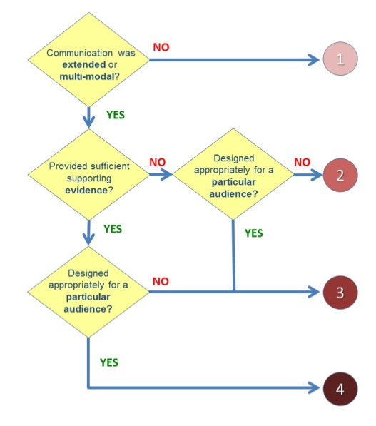
Decision tree

Slide 60

module iIi :
Knowledge Construction

Slide 61
introduction
Many of our education systems were initially designed during the Industrial Revolution and they placed a major emphasis on the teacher sharing information with their students in class. This model of education generally views knowledge as something that is fixed and transmissible, placing a high value on students sitting passively absorbing information and later recalling it either orally or in written form.

Slide 62
introduction
We live in a world that is constantly changing at an ever-increasing pace. In fact, we are swimming in a sea of information. For example, every minute:
  Facebook users share nearly 2.5 million pieces of content.
  Twitter users tweet nearly 300,000 times.
  Instagram users post nearly 220,000 new photos.
  Email users send over 200 million messages.
We need to ask ourselves: is knowledge something static or is it dynamic and constantly evolving?
We also need to be able to effectively make use of this vast volume of information in order to construct knowledge.

Slide 63
introduction
To be able to navigate this volume of information, we need to prepare our students to have more than just the skill of retaining and regurgitating information that others have developed. There is a need for schools to design learning opportunities to move beyond repetition.
We often ask students to answer questions such as What? Who? How? and How Much?, when in reality we need to move beyond these questions that typically have one right answer.

Slide 64

introduction
So we need to move beyond asking students questions that they already know the answer to or that they can search for online instantly. With the advent of internet search engines there is less of a need for them to know lots of facts; instead we should require them to use information to construct their own understandings and engage in purposeful meaning-making.
We want them to construct knowledge by engaging in deep learning where they have to interpret, analyse, synthesise and evaluate information in order to construct understanding. We want them to use their existing knowledge and move beyond mere recall in order to generate ideas or knowledge that is new to them.
Then, once students grasp concepts and ideas in order to deepen their understandings, they need to apply their learning in a new context.

Slide 65
BIG IDEAs of knowledge construction:

Slide 66
BIG IDEA I: knowledge construction
Knowledge construction happens when students do more than reproduce what they have learned; they go beyond knowledge reproduction to generate ideas and understandings that are new to them.
The skills of knowledge construction are often considered “critical thinking.” Activities that require knowledge construction ask students to interpret, analyse, synthesise, or evaluate information or ideas.

Slide 67
Interpretation: means drawing inferences beyond the literal meaning. For example, students might read a description of a historical period and infer why people who lived then behaved the way they did.
Analysis: means identifying the parts of a whole and their relationships to each other. For example, students might investigate local environmental factors to determine which are most likely to affect migrating birds.
Notes:
Inferences: A conclusion reached on the basis of evidence and reasoning

Slide 68
Synthesis: means identifying the relationships between two or more ideas. For example, students might be required to compare and contrast perspectives from multiple sources.
Evaluation: means judging the quality, credibility, or importance of data, ideas, or events. For example, students might read different accounts of an historical event and determine which ones they find most credible.
Notes:
Inferences: A conclusion reached on the basis of evidence and reasoning

Slide 69

EXAMPLES:
IS THESE KNOWLEDGE CONSTRUCTION? | Yes | No
Students searched the Internet for information about local activities to help the environment and analysed the information to decide what else could be done.
Students searched the internet for information about local activities to help the environment and gave a presentation to describe what they found.
A student’s paper compared and contrasted information from multiple sources.
A student’s paper describes information they found online or in books.
Students who have not learned about parallel lines examined several different pairs of lines to develop a definition of “parallel.”
Students used the definition of “parallel” to decide whether several sets of lines were parallel.

Slide 70
EXAMPLES:
IS THESE KNOWLEDGE CONSTRUCTION? | Yes | No
Students searched the Internet for information about local activities to help the environment and analysed the information to decide what else could be done. | X
Students searched the internet for information about local activities to help the environment and gave a presentation to describe what they found. |  | X
A student’s paper compared and contrasted information from multiple sources. | X
A student’s paper describes information they found online or in books. |  | X
Students who have not learned about parallel lines examined several different pairs of lines to develop a definition of “parallel.” | X
Students used the definition of “parallel” to decide whether several sets of lines were parallel. |  | X

Slide 71
BIG IDEA 2:
Knowledge construction as the main requirement
The main requirement is the part of the activity that students spend the most time and effort on and the part that educators focus on when grading. If the learning activity does not specify how much time students should spend on each part, you may have to use your professional judgment to estimate how long students are likely to spend on different tasks.

Slide 72

EXAMPLE.
WHICH ONE OF THE FOLLOWING THE MAIN REQUIREMENT IS KNOWLEDGE CONSTRUCTION?
A student made a short list of important details from a story, then wrote an essay using these details as evidence for why a character committed a crime. | A student made a long list of details from a story, then wrote two sentences to describe why a character committed a crime.

Slide 73
EXAMPLE.
WHICH ONE OF THE FOLLOWING THE MAIN REQUIREMENT IS KNOWLEDGE CONSTRUCTION?
A student made a short list of important details from a story, then wrote an essay using these details as evidence for why a character committed a crime. | A student made a long list of details from a story, then wrote two sentences to describe why a character committed a crime.
Yes | No

Slide 74
BIG IDEA 3: Apply their knowledge
Students must apply their knowledge when they use the knowledge they have constructed to support another knowledge construction task in a new context.
For example, students in a physics class might construct knowledge about heat principles from a study of the Earth’s inner core, and then apply what they learned to investigate the environment of Jupiter

Slide 75
EXAMPLES: ANSWER YES OR NO AND WHY?
DID STUDENTS APPLY THEIR KNOWLEDGE?
Students analysed demographic statistics from their home town and then analysed demographic statistics from a second location of their choice.
No
Students analysed demographic statistics from their home town and then used their understanding of population trends to develop a plan for an upcoming housing development project.
Yes

Slide 76
Example CONT…
Students examined photos enlarged at different sizes to develop an understanding of similarity and then applied that knowledge to abstract geometric shapes, thinking about size ratios and angles to determine which shapes are mathematically similar.
Yes
Students designed and executed a procedure for testing the qualities of the tap water at their school. They tested the water and redesigned the procedure iteratively until they had accurate data.
No

Slide 77
BIG IDEA 4: Interdisciplinary learning activities
Interdisciplinary learning activities have learning goals that involve content, important ideas, or methods from different academic subjects (such as mathematics and music, or language arts and history). Subjects that are typically taught together in your country do not count as interdisciplinary.
For purposes of this unit, ICT is NOT considered a separate academic subject. ICT is often used as a tool for learning in other subjects. For example, students might build ICT skills when they do online research for a history project. This activity is NOT considered interdisciplinary.

Slide 78
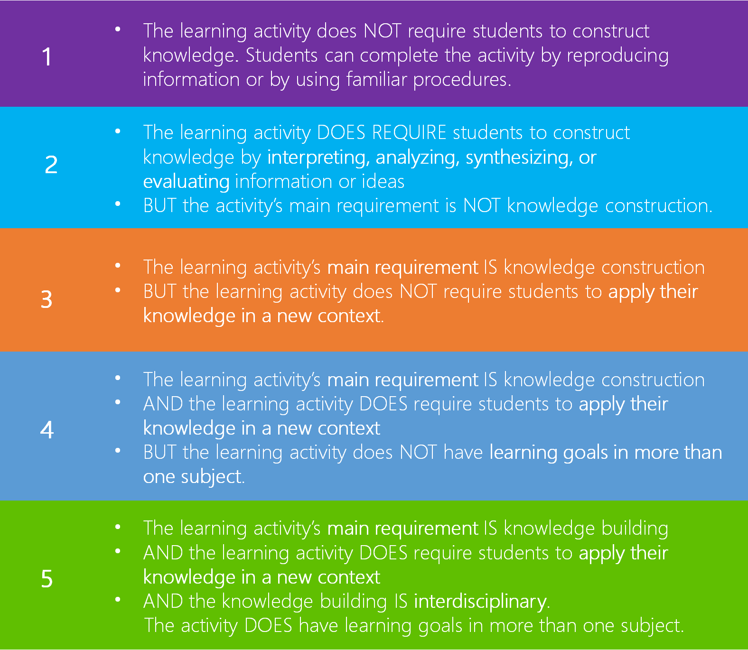
Rubric: Knowledge Construction

Slide 79
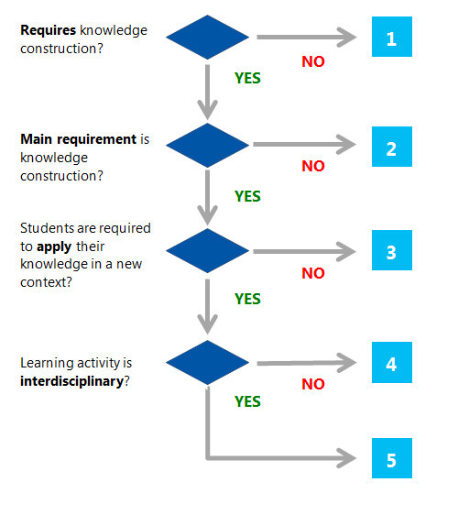
Decision tree: Knowledge Construction

Slide 80
Decision tree: Knowledge Construction
Consider the following activity: students analyze climate data from their locality and then analyze climate data from a second location of their choice. Are the students required to apply their knowledge?
  Yes, because the students are analyzing data from different sources.
  Yes, because the students are applying what they have learned to a new scenario.
  No, because the students do not apply their knowledge from analyzing climatic data to any new activity; they simply repeat the same activity with a different dataset
  No, because the students have not gathered the data themselves
  Yes, because they are using data from more than one source.
  No, because they could choose the second location themselves.

Slide 81
Module iV:
SELF-REGULATION

Slide 82
introduction
Self-regulation occurs when students consciously organize, monitor, evaluate and ultimately take control of their own learning. Educators can design learning activities that assist learners in building and developing their self-regulations skills.

Slide 83
BIG IDEAs of SELF-REGULATION

Slide 84
BIG IDEA I: Long-term activity
A learning activity is considered long-term if students work on it for a substantive period of time. If the learning activity is completed within a single class period, there is no time for students to plan the process of their work nor to improve their work over multiple drafts. Length of time is a basic prerequisite for students’ opportunity for self-regulation.

Slide 85

BIG IDEA Ii: Planning own work
When students plan their own work, they make decisions about the schedule and steps they will follow to accomplish the task. Planning their own work may involve:
  Deciding how: Students break down a complex task into simpler sub-tasks, or choose the tools they will use.
  Deciding when: Students create a schedule for their work and setting interim deadlines.
  Deciding who: A group of students determines how to divide work among themselves.
  Deciding where: Students decide what pieces of the work will be done inside or outside of the school building or the school day.
If a task is long-term but students are given detailed instructions and timelines, they do NOT have the opportunity to plan their own work. Students making decisions about small aspects of tasks does NOT qualify as planning their own work.

Slide 86
DID THESE STUDENTS SUCCESSFULLY PLAN AND MONITOR THEIR OWN WORK?
Over two weeks, students worked in groups to research and debate climate change with their classmates.

Slide 87

BIG IDEA Iii: Opportunity to revise work based on feedback
Students have the opportunity to revise their work based on feedback when feedback is given and explicitly used to improve the work before it is submitted or finalized.
Feedback may come from the educator or from peers. Students might also have the opportunity to revise their work based on their own deliberate process of self-reflection

Slide 88
BIG IDEA Iii: Opportunity to revise work based on feedback
Feedback can be one of the most significant influences on improving learning. Effective feedback helps students to address the gap between current performance and performance goals. It is more than simple praise; comments such as ‘good job’ or ‘great work’ do little to help the student understand what constitutes great work. Effective feedback:
  Tells the student specifically what he or she is doing well and offers specific guidance to help move their learning forward.
  Is directly connected to the learning goals and success criteria.
  Helps the student to be more aware of progress along a learning path.
  Leads to reflection and planning of next steps.

Slide 89
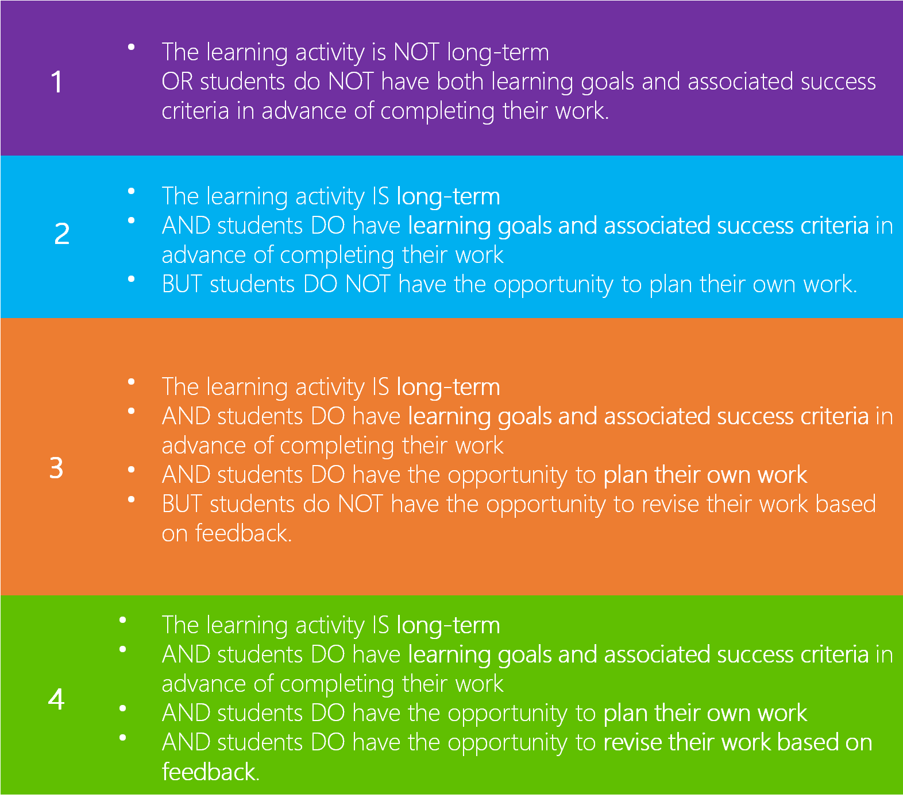
RUBRIC

Slide 90
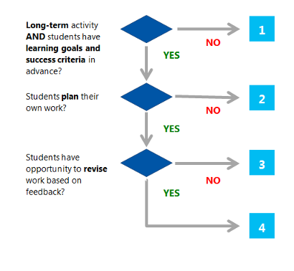
DECISION TREE

Slide 91
module V: real-world problem-solving and innovation

Slide 92

introduction
Real world problem-solving and innovation are skills that are integral to living and working in the 21st century. Educators can provide young people with opportunities to engage in real world problems and to apply their solutions or ideas in practice. This course defines what we mean by problem-solving and the dimensions that should be present in such activities.

Slide 93
BIG IDEAs of real-world problem-solving and innovation

Slide 94

BIG IDEA I: Problem-solving
Problem-solving involves a task with a defined challenge for the student. Problem-solving happens when students must:
  develop a solution to a problem that is new to them OR
  complete a task that they have not been instructed how to do OR
  design a complex product that meets a set of requirements.

Slide 95
CONT
Learning activities that require problem-solving do NOT give students all the information they need to complete the task or specify the whole procedure they must follow to arrive at a solution.
Often, problem-solving tasks require students do some or all of the following:
Investigate the parameters of the problem to guide their approach.
Generate ideas and alternatives.
Devise their own approach, or explore several possible procedures that might be appropriate to the situation
Design a coherent solution.
Test the solution and iterate on improvements to satisfy the requirements of the problem.

Slide 96
Example: IS THIS PROBLEM-SOLVING?
Students rewrote a story from the perspective of a character other than the narrator.
Students learned about pedestrian safety by studying a map showing bus stops and pedestrian crossings.

Slide 97
Example: IS THIS PROBLEM-SOLVING?
Students rewrote a story from the perspective of a character other than the narrator. Yes, Students used the original story but were not instructed how to complete this task.
Students learned about pedestrian safety by studying a map showing bus stops and pedestrian crossings. No, Students were not addressing a defined challenge.

Slide 98
BIG IDEA II: Real-world problems
Real-world problems are authentic situations and needs that exist outside an academic context.
Real-world problems:
  Are experienced by real people.
  For example, if students are asked to diagnose an ecological imbalance in a rainforest in Costa Rica, they are working with a situation that affects the real people who live there.
  Have solutions for a specific, plausible audience other than the educator as grader.

Slide 99
BIG IDEA II: Real-world problems
  For example, designing equipment to fit a small city playground could benefit the children of the community.
  Have specific, explicit contexts.
  For example, developing a plan for a community garden in a public park in their town has a specific context; learning which vegetables grow best in which parts of one’s country does not.
  If students are using data to solve a problem, they use actual data.
  For example, real scientific records of earthquakes, results of their own experiments, or first-person accounts of an historical event, not data developed by an educator or publisher for a lesson.

Slide 100
BIG IDEA III: Innovation
Innovation requires putting students’ ideas or solutions into practice in the real world. For example, it is innovation if students design and build a community garden on the grounds of their school; just designing the garden is NOT innovation.
In cases where students do not have the authority to implement their own ideas, it is innovation ONLY if students convey their ideas to people outside the classroom context who can implement them. For example, it is innovation if students present their ideas for building a community garden in a public park in their town to a local environmental group or to local officials, but NOT if students design a community garden for that public park and only share their plans with their teacher and classmates.

Slide 101
BIG IDEA III: Innovation
Innovation also benefits people other than the student; it has value beyond meeting the requirements of a classroom exercise. The town s' people who tend the new garden in the public park and the teenagers who attend the rewritten Shakespeare play benefit from students’ efforts, for example.
It also counts as innovation if students create a project for a science fair or submit an original poem to a regional poetry contest, for example, because the fair and contest are not educator-controlled and have real audiences who are interested in and may benefit from the students’ work.

Slide 102
Example: ARE THESE REAL-WORLD PROBLEMS?
Students used a bus map in a textbook to propose where pedestrian crossings should be added in a fictional town.
  No, This did not involve actual data.
Students used their town’s bus map to propose where pedestrian crossings should be added in their town.
  Yes, This had a specific, explicit context. Students used actual data to do this.
Students investigated whether growing plants in their classroom could improve the air quality.
  Yes, Even though the setting was the classroom, air quality is a real issue.

Slide 103
Rubric - Real-World Problem-Solving and Innovation

Slide 104
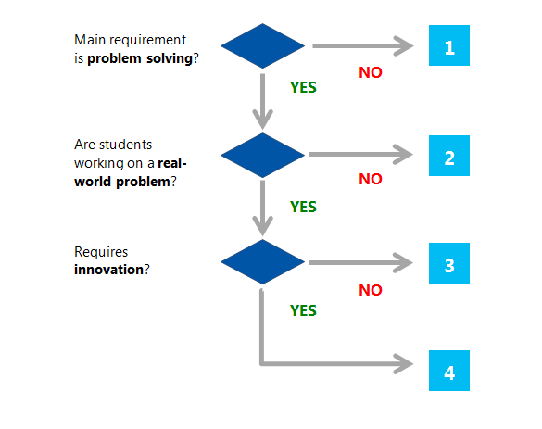
Decision Tree - Real-World Problem-Solving and Innovation

Slide 105

Module VI:
Use of ICT for Learning

Slide 106
introduction
Information and communication technologies (ICT) have become commonplace in all aspects of life, including education. The use of ICT in education all too often supports the consumption of information and ideas. 21CLD: ICT for Learning highlights the need to use ICT to transform learning experiences and to create and design new information.

Slide 107
The Big Ideas - Use of ICT for Learning

Slide 108
BIG IDEA I: Student use of ICT
Student use of ICT happens when students use ICT directly to complete all or part of the learning activity. The educator’s use of ICT to present materials to students does not count as student use of ICT: it is important that students have control over the ICT use themselves.
Some educators’ use of ICT can enhance their teaching significantly: for example, educators can show simulations that make difficult content easier for students to visualise. However, this rubric focuses only on how the learning activity requires students to use ICT in their learning.
It is considered ICT use if the students are required to use ICT or can use ICT to complete an activity.

Slide 109
Example: IS THIS STUDENT USE of ict?
A student used a worksheet printed by the teacher to complete a math learning activity.
  No
Students learned about cell replication by watching the teacher demonstrate a software simulation of the process.
  No
A student wrote a report using a word processing program, with edits tracked by the student.
  Yes
Students learned about cell replication by using a software simulation to explore the process.
  Yes

Slide 110
BIG IDEA II:
Use of ICT to support knowledge construction
Knowledge construction occurs when students generate ideas and understandings that are new to them, through interpretation, analysis, synthesis, or evaluation. This unit examines whether the learning activity requires that students use ICT in ways that support knowledge construction, either directly or indirectly.
ICT supports knowledge construction when:
  Students use ICT directly for the knowledge-construction part of a learning activity. For example, students use a computer to analyse scientific information.
  Students use ICT to indirectly support knowledge construction, by using ICT to complete one step of an activity, and then using information from that step in the knowledge-construction part of the activity. For example, students might search for terms related to current events on Twitter and then analyse people’s responses offline. The information they found on Twitter supported their analysis, so we say that ICT use supported knowledge construction.

Slide 111

BIG IDEA II: Use of ICT to support knowledge construction
  The knowledge construction supported by ICT must be about the learning goals of the activity: learning to use the ICT does not qualify. For example, students might learn about PowerPoint as they create a presentation for history class. But to be considered knowledge construction using ICT, it is essential that the use of PowerPoint helped them to deepen their interpretation, analysis, synthesis, or evaluation of historical ideas, not just to deepen their knowledge on how to use the tool.
  Evaluation of Internet resources related to the learning goals is also considered knowledge construction. Some learning activities are designed to help students become intelligent, ethical users of Internet resources rather than passive consumers of the information. For example, students might be required to find several sources on a topic and evaluate their credibility before they select which information to rely on.

Slide 112
BIG IDEA III: ICT required for knowledge construction
ICT is required for the knowledge construction when it allows students to perform knowledge construction activities that would be impossible or impractical without the use of the ICT. For example, students might be asked to communicate with students in another country over a period of two weeks to research the impact of a recent drought on their community. In this case, emails enable students to construct knowledge that they could not construct without ICT because mailing physical letters would be impractical in this short a time. The use of email is required for constructing this knowledge.
Many activities that require knowledge construction can also be done without ICT. For example, students may be asked to find information about the beaks of a variety of bird species with different diets and develop categories of different types of beaks. If students use the Internet for this activity, they are constructing knowledge, but ICT is not required: they would be able to achieve the same learning goals without ICT by using printed books in a library.

Slide 113
BIG IDEA IV: Designers of ICT products
Students are designers of ICT products when they create ICT products that others can use. For example, if students record a podcast and make it available on the internet, they are creating an ICT product that others could use. The product lasts beyond the learning activity and can be used or enjoyed by an outside audience.
When students act as designers of ICT product, ICT is supporting their real-world problem-solving and innovation. Students must have an authentic audience in mind, such as a community that needs the information their podcast will provide, or younger students who will learn about disease prevention from the simulation students are building. In their design, students must attend to the needs and preferences of that audience. Ideally, but not necessarily, the product might actually be used by the intended audience. Students who create a product with no particular audience in mind do not qualify as designers under this definition.

Slide 114
Rubric - Use of ICT for Learning

Slide 115
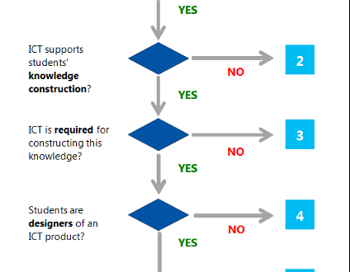
Decision Tree - Use of ICT for Learning

Slide 116

Module VII: Introduction to Inclusive Digital Literacy

Slide 117
Reflective question
Have the teachers and non-teachers in your education setting developed a shared understanding of the term digital literacy?
"Digital Literacy is as important as reading writing and maths"
Discuss with colleagues.

Slide 118
introduction
Digital technologies are now ubiquitous in the home, in school, in the workplace. It is easy to take this for granted but it is important to consider these questions:
  Can we make available and emerging technology work harder for us?
  How can we equip every young person (especially those with special education needs and disabilities) to be digitally literate in a world where government is now on-line, banking, insurance, and shopping are on-line as well as much of our social and leisure lives too?
  Are educators exploiting the digital resources we already have to the full?
  Is technology simply replacing tasks, or is technology opening new frontiers in terms of accelerating learning and personalising the education experience?

Slide 119
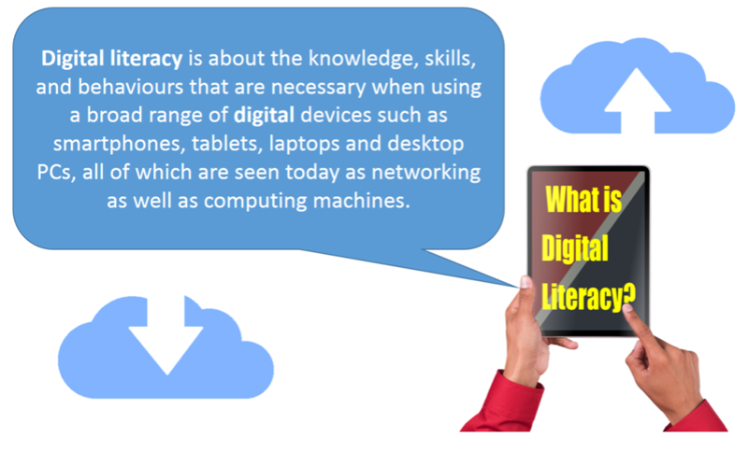
introduction

Slide 120
The Fourth Industrial Revolution:
What you can do
Watch the video from the World Economic Forum.
https://youtu.be/kpW9JcWxKq0 (To be downloaded and watch offline)
Ubiquitous, mobile supercomputing, Artificially-intelligent robots, Self-driving cars, Neuro-technological brain enhancements, Genetic editing. The evidence of dramatic change is all around us and it's happening at exponential speed. Previous industrial revolutions liberated humankind from animal power, made mass production possible and brought digital capabilities to billions of people. This Fourth Industrial Revolution is, however, fundamentally different. It is characterized by a range of new technologies that are fusing the physical, digital and biological worlds, impacting all disciplines, economies and industries, and even challenging ideas about what it means to be human.

Slide 121
The Fourth Industrial Revolution:
Reflective questions
Think about your education setting: the children and young people in your classes, the way learning is organised, managed and delivered within your education setting. Whatever age you teach, be it pre-school, primary or secondary, the learners in your care are on a life-long learning journey into, and in some cases, beyond the 21st century:
  Does your education setting's mission and vision statement say anything about what you do to prepare the children and young people in your care for the social and economic challenges that they will face over a working life of perhaps 60 years and a longevity that may well see them active well past the age of 100?!
  Laying the foundations for life-long learning should be the imperatives that drive any education setting. How does your education setting articulate these imperatives? Literacy and numeracy goals? As standards of exam performance? As social and societal outcomes? As a set of capabilities, attitudes and social/cultural expectations?
  How do you create a learning culture that acknowledges the role technology plays in supporting working, learning and living in the 21st century? After watching the video, how could your setting do better?
Answer one of these questions to share how your school prepares its students for the future.

Slide 122
Workplace Trends and the Importance of Digital Literacy: Future Work Trends
"...As technology becomes more pervasive, traditional trades disappear and the world of work becomes more globalised, the skills considered to be valuable for the future are shifting.
Problem solving, team working, and communication (commonly known as "21st century skills") are the most-needed skills in the workplace, according to our recent surveys of business executives, students and teachers. Digital literacy and creativity— and the latter's close relative, entrepreneurship—are expected to grow more important in the next three years.

Slide 123
Steps to Introducing Child-Centred Innovation in Digital Literacy to Your Learner Community
STEP 1 THINK ABOUT THE LEARNER
  Think about a learner, or small group of learners, that will be your target group.
  Think about an area of learning where you would like to see accelerated progress. How will you measure progress? What evidence will you need to collect? As you proceed through the Courses, keep reflecting on this initial selection, to see if your new learning is relevant to their needs and their learning objectives.
STEP 2 THINK ABOUT YOUR KNOWLEDGE AND SKILLS
  Use one of the Audit Tools in "Developing a Digitally Literate Pedagogy" to self-evaluate your current digital literacy levels, or to give you ideas about what areas of digital literacy you would like to personally develop.

Slide 124
Steps to Introducing Child-Centred Innovation in Digital Literacy to Your Learner Community
STEP 3 THINK ABOUT MEANINGFUL ACTIVITIES
  After completing "Developing a Digitally Literate Learner", reflect on the Digital Literacy abilities and capabilities of your target cohort:
  What can you do to make them aware of their own personal next steps in terms of digital literacy development?
  How can you build meaningful activities into their overarching learning objectives that enable them to rehearse and develop these "next steps"?
STEP 4 THINK ABOUT APPLICATION OF DIGITAL TECHNOLOGIES
  After completing "Developing a digitally Literate Curriculum" decide on what digital technologies you will choose to support the ambition outlined in Steps 2 and 3:
  You may wish to liaise with colleagues with IT responsibilities so that you use language and approaches already in train within the educational setting.

Slide 125
Steps to Introducing Child-Centred Innovation in Digital Literacy to Your Learner Community
STEP 5 START THE LEARNING JOURNEY!
  Collect some baseline evidence from your target cohort, then apply some new learning, or new approaches, to your target cohort
STEP 6 HOW DID IT GO?
  Review and evaluate the progress that has been made.
  How can the practice you have developed:
  a) be applied to other learners
  b) be shared with other colleagues
  c) what next steps need to/ Can be taken?

Slide 126

Module VIII: Teaching with Technology.

Slide 127
introduction
Office 365 provides the right environment for better learning outcomes. In this learning path, educators will learn how to become more innovative with cloud-based tools, regardless of the device they use. In this course, learn how to use basic features of Office 365 including Microsoft Teams, OneNote, Sway, Microsoft Forms, Office Online and OneDrive.

Slide 128

Microsoft Sway
From student reports to monthly newsletters, today's classrooms have many stories to tell. Digital storytelling with Microsoft Sway lets teachers and students focus on the content and not worry about the format. This course will show how Sway can be used to capture and share the digital stories that need to be told.

Slide 129

Microsoft forms
With Microsoft Forms, you can create surveys, quizzes, and polls, and easily see results as they come in. When you create a quiz or survey, you can invite others to respond to it using any web browser, even on mobile devices. As results are submitted, you can use built-in analytics to evaluate responses. Form data, such as quiz results, can be easily exported to Excel for additional analysis or grading.

Slide 130

Microsoft onenote
With Microsoft OneNote, educators can create digital notebooks that support academic standards and education outcomes across disciplines and tasks, such as writing, reading, mathematics, science, history, CTE, and elective courses. Students may use OneNote across content areas and grade levels, and use OneNote to compile and organize unstructured information, research, and content. OneNote also supports research, collaboration, information management, communication, note taking, journaling, reflective writing, and academic requirements.

Slide 131

Microsoft teams
Microsoft Teams is a digital hub that brings conversations, content, and apps together in one place. Educators can create collaborative classrooms, connect in professional learning communities, and communicate with school staff all from a single experience in Office 365 for Education.

Slide 132
unit IX: Microsoft Innovative Educator.

Slide 133

Microsoft Innovative Educator (MIE)
Microsoft supports a thriving community of passionate educators who are constantly learning, growing and working together to change students' lives and build a better world. The Microsoft Innovative Educator (MIE) Expert program is a premier program created to recognize global educator visionaries like yourself
https://education.microsoft.com/en-us

Slide 134
THANK YOU

