Slide 1
UNIT 8: ICT & POLICY
Discuss the role of ICT in education in the realization of the national vision 2020

Slide 2
Introduction:
In order for Rwanda to achieve the objective, it will have to develop the teaching of science and technology at secondary and university levels. It will facilitate the creation of high and intermediate technology enterprises and develop access to ICT down to the administrative sector level, in accordance with the national ICT plan.
information technology modal aspect of information maybe more essential for development of relations between person and computer.

Slide 3
The role of CT in education to realize of the national vision 2020
ICT is used in the following areas:
In education: Information and communication technologies potentially offer increased possibilities for codification of knowledge about teaching and for innovation in teaching activities through being able to deliver learning and cognitive activities anywhere at any time. Learning at a distance can furthermore be more learner-centred, self-paced, and problem solving-based than face-to-face teaching.
example :using e-learning , having smart classroom.

Slide 4

2. ICT in Business
ICT in a business environment can be used for:
  Recording Data, Storing data, Manipulating data and Retrieving data
ICT is Used in
  Administration- Invoices, Communication, Emails
  Business, Finance and Accounting- Business Plans, Financial forecasting, Auditing, Market Analysis, Research, Recording Transactions
  Communications- email, instant messages, mobile phones
  Engineering and Creative Art- 2D and 3D Drawing, Modelling, Simulation
  Wildlife and Tourism and Hospitality- Animal Tracking, Hotel booking, GIS

Slide 5
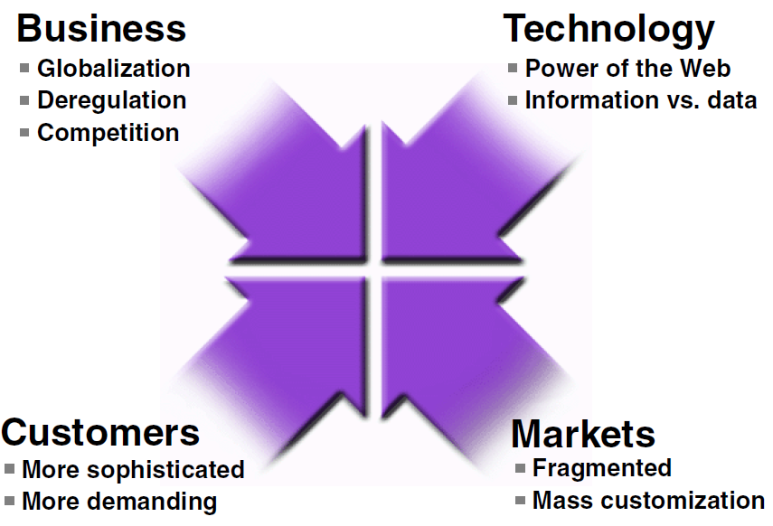
Changing Business Landscape
Global reach of Internet Technology: mobile phones can handle Internet communications
Pervasive Computing- idea of putting powerful computer chips and functions into everyday things such as cars or household appliances. Fridges can now scan itself and inform you to procure goods online using GPS and location technologies
The term “global”
includes: global markets, global customers, global suppliers, global
shareholders, and global opportunities.
Highly competitive with
companies competing across national boundaries

Slide 6
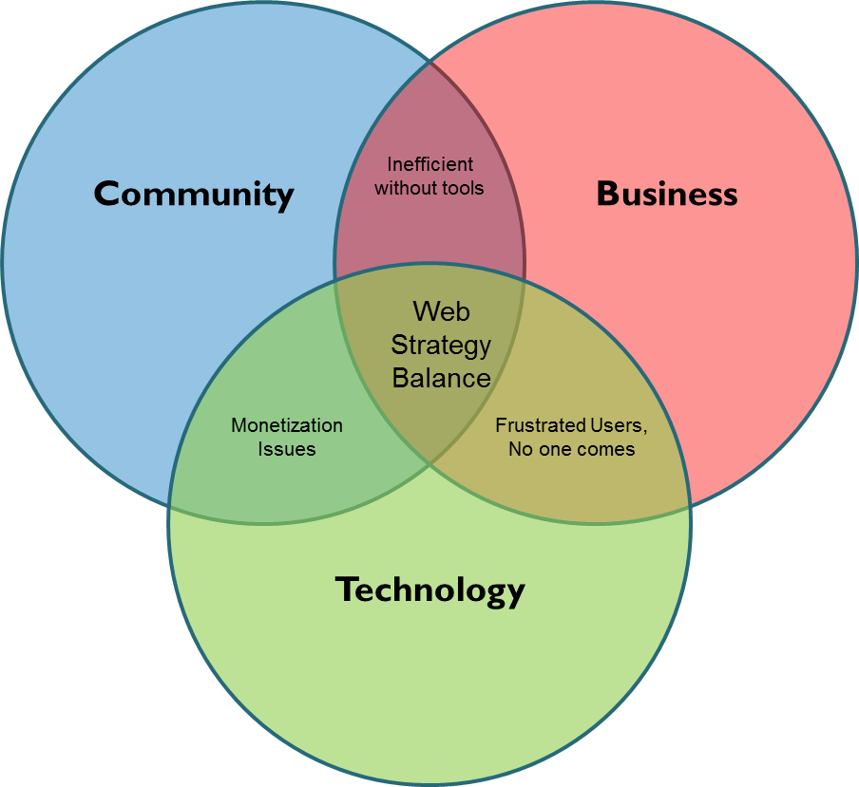
Three Spheres of Web Strategy

Slide 7
Technological Components
Hardware
Software
Word Processing
Spreadsheet
Graphics
Games
Communication
Graphics
Databases
Operating Systems
File Management Tools
Utilities
Compilers
Debuggers
Assembler
Application Software
Systems Software

Slide 8
Internet, Email and E-Commerce
Internet
Global Market Place
E-Commerce
Market Performance
Price Comparison Sites
E-Mail
Messages can be sent to individuals and groups
Quick Information Transfer
E-Commerce
Shopping 24/7
Low Overheads
Global Market
E-Marketing

Slide 9
3. Medecine
Health information technology (HIT) is the application of information processing involving both computer hardware and software that deals with the storage, retrieval, sharing, and use of health care information, data, and knowledge for communication and decision making. HIT, technology represents computers and communications attributes that can be networked to build systems for moving health information.
example: using drones and other medical tasters.

Slide 10
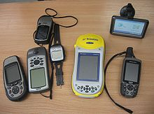
4. In agriculture
In agriculture, the use of the Global Positioning System provides benefits in geo-fencing, map-making and surveying. GPS receivers dropped in price over the years, making it more popular for civilian use. With the use of GPS, civilians can produce simple yet highly accurate digitized map without the help of a professional cartographer. The following are the GPS receivers

Slide 11
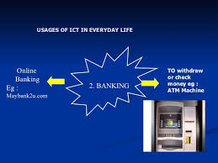
5. In banking
The role of information technology (IT) in the banking industry. ... More than most other industries, financial institutions rely on gathering, processing, analyzing, and providing information in order to meet the needs of customers. for example using ATM card

Slide 12
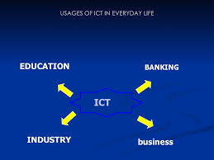
Conclusion
ICT plays a big roles in the following areas such as education, banking, industry, business as shown in the figure bellow

Slide 13
Presented by Celestin NTUZIBAGIRWE
END!!!!!

