Slide 1
Unit 13 - ICT and Physical Environment
Done by
Albert Sinamenye

Slide 2
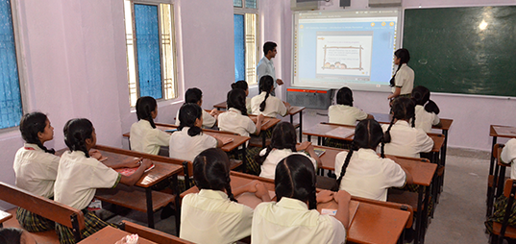
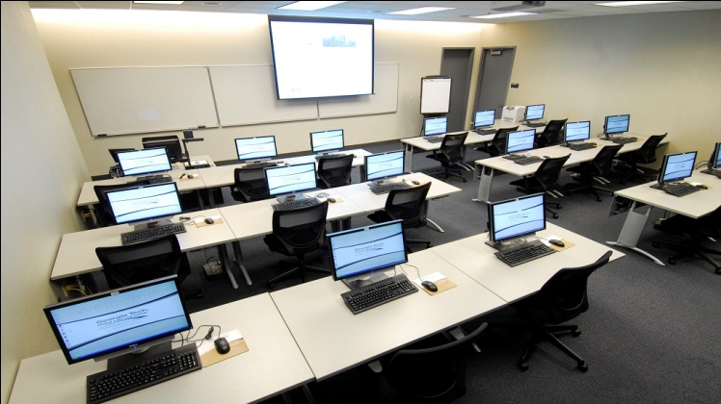
Introduction
A computer lab is a space which provides computer services to a defined community. Computer labs are typically provided by libraries to the public, by academic institutions to students who attend the institution, or by other institutions to the public or to people affiliated with that institution. Users typically must follow a certain user policy to retain access to the computers.

Slide 3
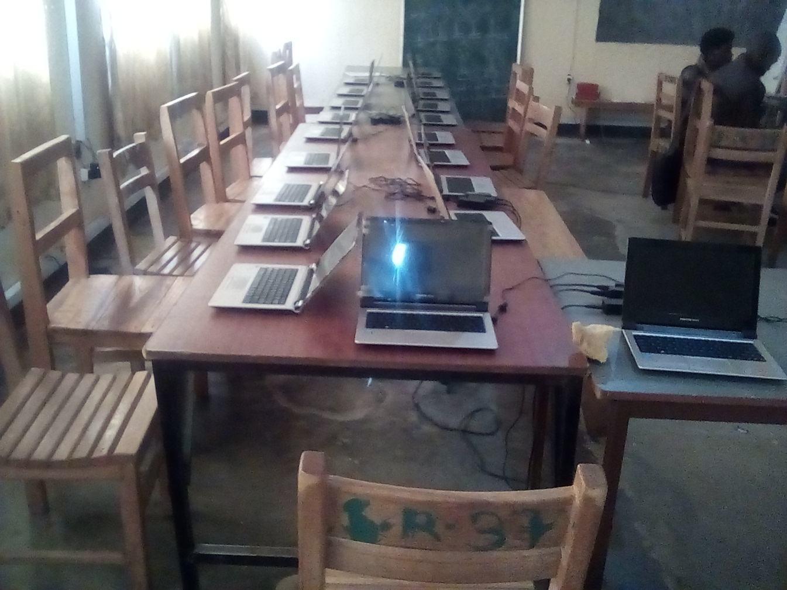
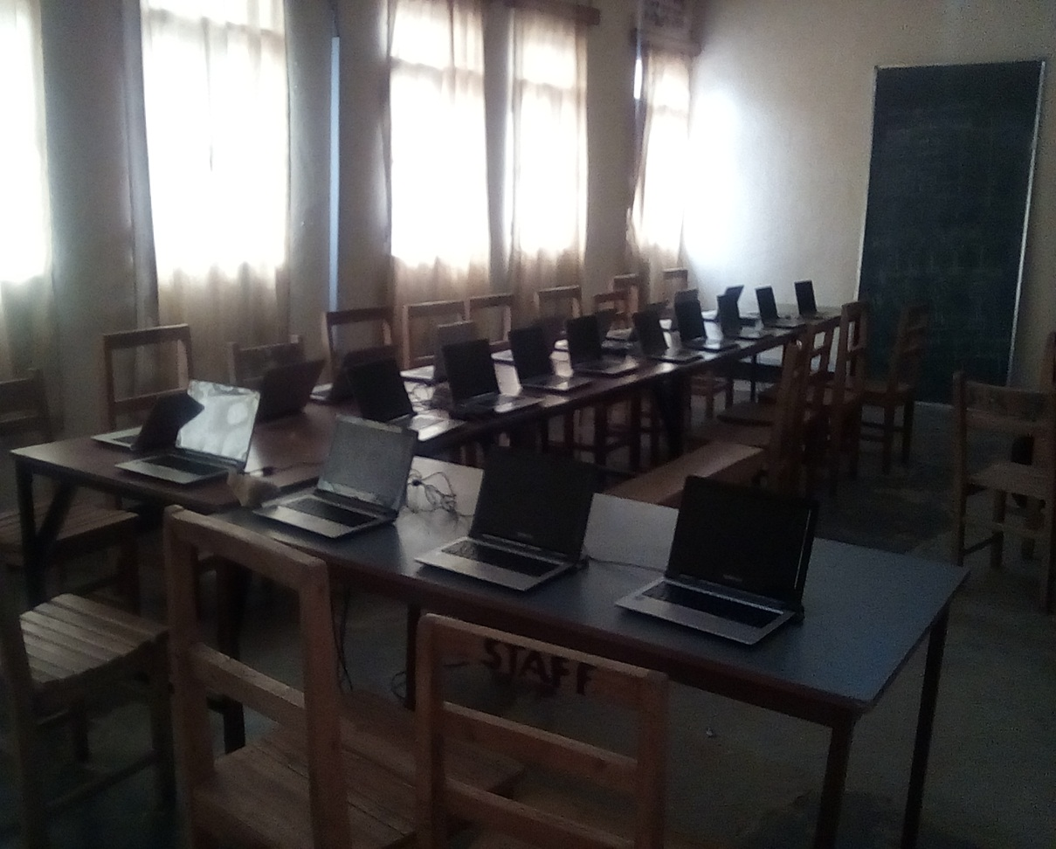
Lay out of our computer labs
Our school E.S Rukomo SOPEM has two computer labs with 100 laptops (45 laptops and 55 laptops). They are all connected to internet where all learners are able to search online the contents of every current lesson prepared.

Slide 4
Our rules and regulation in computer lab

Slide 5
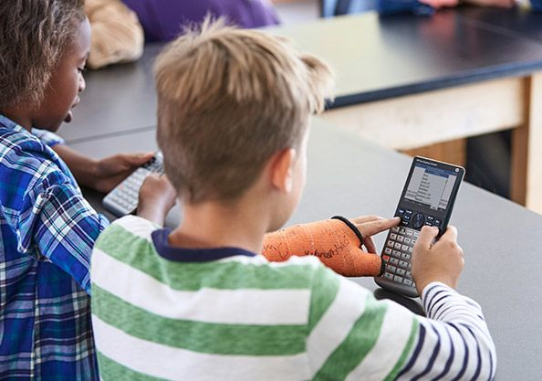
ICT Tools and systems in learning:
Mobile devices;

Slide 6
Advantages and disadvantages of using cell phones in schools
Advantages :
I think cell phones should be allowed in school because if you forget something at home you could call your parents to bring it to school. Like when you forget your homework. Also when your staying at school and you forget to tell your parents that your staying at school, and or you want to go somewhere after school to hang out with your friends.
Disadvantages:
If a student decides to bring his or her cell phone to school, there is a possibility that they would use it in class while no one knows. Then, once they get used to doing that, they will start texting while they take a test. This can cause a big increase in cheating.

