Slide 1
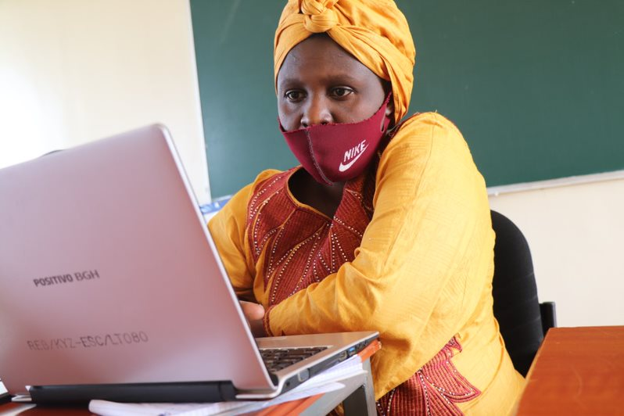
Scratch – Module 8 –Hackathon Competition

Slide 2
Module 8
A Hackathon?
A hackathon is an event where programmers get together for a short period of time to collaborate on a project and compete with one another. As part of the Scratc²h project, it is your turn to showcase your Scratch coding skills and to compete with your fellow students!

Slide 3
Module 8
WHAT IS THE HACKATHON IS ABOUT?
There is no limit to a hackathon theme for this competition. The theme can be linked to your personal interest or studies. Here are some examples:
EXAMPLES OF THEMES
Animate a vehicle navigating from one location to another with the shortest path (Math, ICT).
Animation for Chemical bonds-mixtures (Chemistry)
Animation for circulatory system (Biology)
Electricity to show how electrons move in each circuit diagram (Physics)
Plotting a Quadratic equation to the XY Coordinates (Mathematics)

Slide 4
Module 8
Evaluation of projects
Each Scratch project will be assessed on the following criteria: coding skills, creativity, and presentation skills:
Evaluation criteria | Explanation | Weight
Coding skills | Ability to use Scratch | 50%
Creativity | Logic and meaning of the project | 30%
Presentation skills | Ability to explain the logic behind the project | 20%

Slide 5
Hackathon
Who can participate?
Any student that is part of a Scratch coding club in the period January – May 2022 in Kayonza district can participate. To enhance collaboration, you are encouraged to form teams and work together. A team should consist of at least 2 students and maximum 4 students. Each team should consist of at least 1 boy and 1 girl.

Slide 6
Hackathon
Competition rules and timeframe
 | Competition level | Instruction | Submission format | Submission deadline | Awarding of winners
1 | Coding club level | Students submit their project using the form link and present their project during the coding club session | Form link | 1 December | 1 winner per club is selected by the coding club teacher on 1 December. The best project will be submitted to this link
2 | School level | Students adjust their project and present to the school Scratch committee | During school Scratch committee meeting | 8 December | 1 winner per school is selected by the school Scratch committee (3 Scratch teachers and head teacher) on 8 December. The best project will be submitted to this link.
3 | Sector level | Students adjust their project and submit online (no presentations) | Submission link on Moodle | 11 December | 1 winner per sector is selected by Scratch trainers on 13 December. The best project will be submitted to this link.
4 | District level | Students can adjust their project and present at the Scratch Day | During Scratch Day | 18 December | 3 winners are selected by the Scratch core team. The best projects will be submitted to this link.
Adapt for 2nd coding cycle

Slide 7
Module 8
Hackathon Roadmap

Slide 8
Hackathon
Prepare your team
Prepare a presentation using the PowerPoint template and upload it.
Tips and tricks
Work with short and powerful sentences, and use the right images that support and/or reinforce the message.
Try to avoid running text and excessive animations.
You can’t explain everything in 8 minutes, make deliberate choices.
Make the audience curious so that they ask questions during the Q&A
If you need hep in preparing the presentation, read the instructions!

Slide 9
Hackathon
Prepare your team
Decide with your team who is going to be the spokesperson for your team. Or divide the slide deck between multiple members of the team.
Write down a script or – even better- some keywords that you can use as a support during the presentation
Practice the presentation a few times.
Let others watch and let them give feedback on your presentation skills.
Use a timer to see if you are not exceeding the time limit of 8 minutes.

Slide 10
Module 8
Scratch day
The top 3 Scratch projects of the district will be awarded during the Scratch Day.
Are you ready to start your project?!
Are there questions?

