Slide 1
Scratch – Module 6-7 Games

Slide 2
Games

Slide 3
Module 6-7
Overview and learning outcomes
Apply the computational concepts of conditionals, operators, and data.
Apply the computational practices of iterating, testing, debugging, and reusing, abstracting, and modularizing by building game projects.
Identify and use common game mechanics.
Notes:
In this module, you will learn about designing games in Scratch. You will learn how to create variables and Lists of data to store information and characteristics of sprites. These are key skills that you need in the creation of games. Lastly, you will learn how to use sensing blocks to detect a certain movement or event to trigger an action.

Slide 4
Module 6-7
Introduction
Module 6-7 : Games
Engage
What are your favorite games?
Demonstrate
Design process
Introduction to variables and data
Game design
Adding a score and timer to the game
Technical Game Plan
Logical operators
Experiment
Activity 1: Design your dream game
Activity 2: Game Fair
Activity 4: Feedback group
Reflect
Additional materials for Module 6-7

Slide 5
Engage

Slide 6
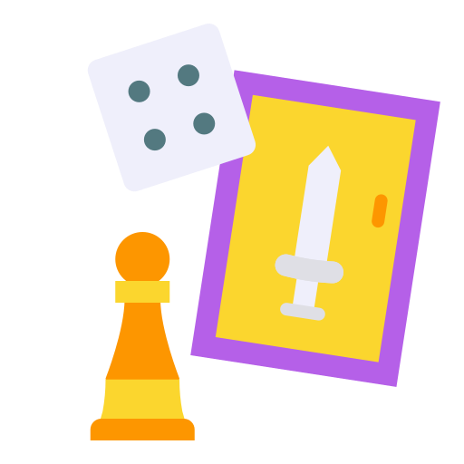
Module 6-7
What is your dream game?
What are your favorite games?
In your group, generate a list of games that you enjoy playing. Write down as many games as you can think of. (5 min)
Chose your 3 favorites from the list.
Class discussion
What do the games have in common?
What features of their design make them a game?

Slide 7
Module 6-7
What is your dream game?
Imagine your dream game. Write a list of characteristics/ elements for that game.
share your dream game lists in your group

Slide 8
Module 6-7
Game design process
6. How to end or win the game
5. How to start
4. Goals of the game
3. Rules of the game
2. How to play the game?
1. What the game is about?
Notes:
The Design Process is an approach for breaking down a large project into manageable sections. The process defines each step to tackle each project and remind us to sketch all our ideas throughout the process. This process is used to design and develop a game in Scratch. We need to break the project into small parts to get a better understanding of each section and ease the implementation process. In the process of designing the game, there are 4 things we need to ask ourselves.
What is the objective of the game?
What is the operation process of the game?
Do they need to move the mouse around?
What are the challenges to overcome?
Do they need to run out of fuel, life meter, etc.)
What to let the user know s/he won or lost?
screen

Slide 9
Demonstrate

Slide 10
Module 6-7
Design process
What is the objective of the game?
What is the operation process of the game?
Do they need to move the mouse around?
What are the challenges to overcome?
Do they need to run out of fuel, life meter, etc.)
What to let the user know s/he won or lost?
screen
Notes:
The Design Process is an approach for breaking down a large project into manageable sections. The process defines each step to tackle each project and reminds us to sketch all our ideas throughout the process. This process is used to design and develop a game in Scratch. We need to break the project into small parts to get a better understanding of each section and ease the implementation process. In the process of designing the game, there are 4 things we need to ask ourselves.

Slide 11
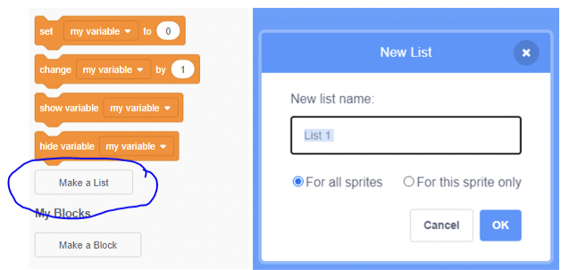
Module 6-7
Introduction to variables and data
Variables
Creating a variable
Using a created variable
Data
Creating values of lists
Notes:
The Design Process is an approach for breaking down a large project into manageable sections. The process defines each step to tackle each project and reminds us to sketch all our ideas throughout the process. This process is used to design and develop a game in Scratch. We need to break the project into small parts to get a better understanding of each section and ease the implementation process. In the process of designing the game, there are 4 things we need to ask ourselves.

Slide 12
Module 6-7
Game design
Creating characters
Inserting a sprite
Creating a sprite
Inserting touch detection
Notes:
In game designing, the process is the same as the design process with a focus on games.

Slide 13
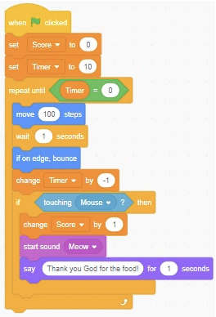
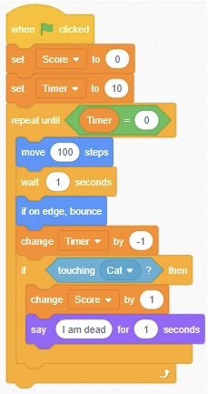
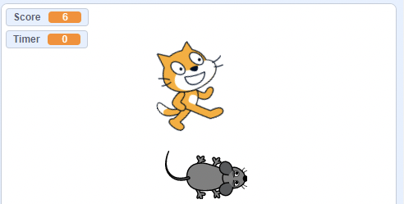
Module 6-7
Adding a score and timer to the game
Cat
Mouse
Adding a score and timer to the game
Notes:
In game designing, the process is the same as the design process with a focus on games.

Slide 14
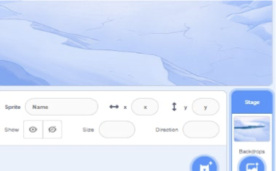
Module 6-7
Technical Game Plan
How the stage will look like?
Each game needs a matching stage.
A stage adds a meaning to the game and story.
So, always to choose a stage that matches your story or game.

Slide 15
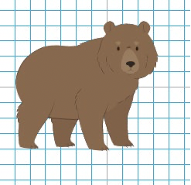
Module 6-7
Technical Game Plan
Which sprite to use?
A sprite is a character in the story or an actor in the game.
For each story or game, you will choose or create a sprite based on its role, characteristics and other factors.

Slide 16
Module 6-7
Technical Game Plan
Game flow?
After you have identified the sprite and the stage, you need to determine what the player will do.
Which buttons to click and how to start the game. Most people use when you click the green flag, but you can choose other options.
You describe what will happen and when it happens from the beginning of the game to the end. In the game flow, you also mention how to win your game.

Slide 17
Module 6-7
Technical Game Plan
Sound Effects/Music
In some games, there are sounds played in the background and each sound affects the game in one way or another.
There are cases where each sprite produces a sound. In this section of planning, it is better to assign each sprite a sound and if possible, record or upload what you already have.
In that category, you can provide each sprite with an associated sound effect.

Slide 18
Module 6-7
Logical Operators
Using Logical operators in game design
The result is true only if both expressions are true
The result is true if one of the two or both expressions are true
The result is true if the expression is false

Slide 19
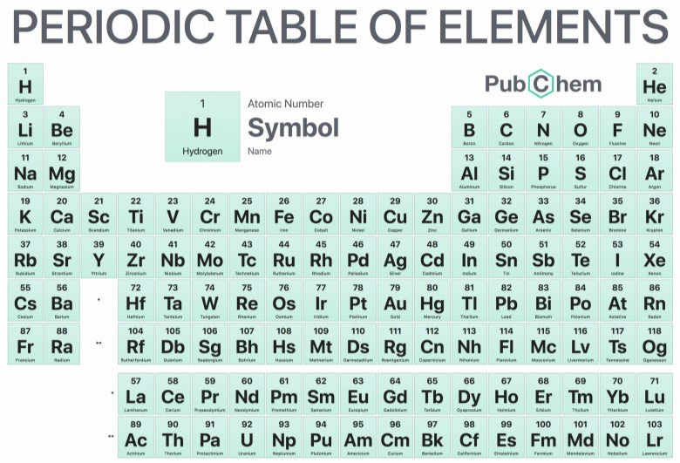
Module 6-7
Logical Operators
Periodic Table game
About the project? This game is going to help students master periodic table elements and their corresponding proton number.
How will your project work? Students will get a random element and they will have to enter its proton number.
What are the rules? Fill in the Proton number/atomic number that corresponds to the selected element.

Slide 20
Module 6-7
Logical Operators
Periodic Table game
What are the goals? The goal is to see if you master the periodic Table elements and their atomic number.
How do you start? To start the game, you need to press the Letter “P” on the keyboard.
How do you end or win? If the answer is correct you get one point, otherwise you lose one point, and five mistakes will mean the end of the game.

Slide 21
Experiment

Slide 22
Module 6-7
Design your Dream Game
Design your Dream Game
Fill in the game design template here
Create your game! Look at some examples in the Game studio such as Maze, Pong, and Scrolling
Consult the lesson plan on module 2 for a detailed description of this activity.
Notes:
Make sure that they complete all the guided practices.

Slide 23
Module 6-7
Game Fair
Game Fair
Half of the students stay in their seats with their projects open while the other half walks around trying out the games, asking questions, and giving feedback, then we switch sides.
Consult the lesson plan on module 2 for a detailed description of this activity.
Notes:
Make sure that they complete all the guided practices.

Slide 24
Module 6-7
Activity 4 : Feedback groups
When you are ready share your game with a 'feedback group’.
A feedback group is a small group where each one shares their projects-in-progress with one another in order to get feedback and suggestions for further development.
Respond to the following questions:
What is something that doesn’t work or could be improved?
What is something that is confusing or could be done differently?
What is something that works well or you really like about the project?
Tip:
Take notes of the feedback and suggestions you get

Slide 25
Reflect

Slide 26
Module 6-7
Reflection
Questions
What was challenging about designing your game?
What are you proud of?
What was the main feedback you got from your fellow coders?
What would you like to improve still?

Slide 27
Module 6 - 7
Additional Materials
Lesson Plan Module 6-7
Scratch_ Game Design Document Code Club -shared.docx

