Slide 1
Scratch – Module 5 - Polygons and flowers

Slide 2
Polygons and Flowers

Slide 3
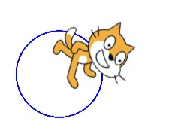
Module 5
Objectives of module 5
By the end of this module, you will be able to:
Use repeat controls to draw shapes and images.
Learn about the function of a pen

Slide 4
Module 5
Introduction
Module 6-7 : Games
Engage
What are polygons?
Demonstrate
Pen blocks
Drawing angles
Experiment
Activity 1: Angles
Activity 2: Design your own sprite
Activity 4: Feedback group
Reflect
Additional materials for Module 5

Slide 5
Engage

Slide 6
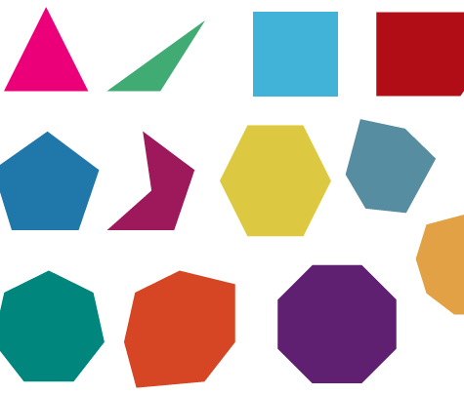
Module 5
What is a polygon?
What is a polygon ?

Slide 7
Module 5
What polygons do you know?
What polygons do you know ?

Slide 8
Module 5
Fill in!
Polygon | Number of sides | Number of angles | Number of triangles | Sum of all angles (degrees) | Measure of one angle (degrees)
Triangle |  |  |  | 360
Rectangle |  |  |  | 360
Pentagon |  |  |  | 360
Hexagon |  |  |  | 360

Slide 9
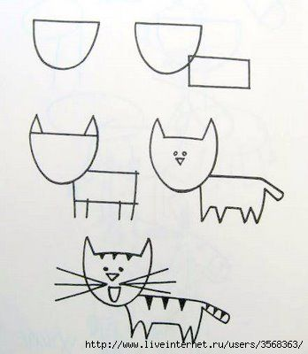
Module 5
Why are polygons useful?
Polygons are useful in Scratch to draw all kinds of sprites

Slide 10
Demonstrate

Slide 11
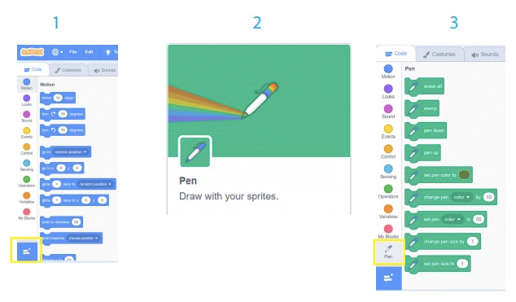
Module 5
Pen blocks
Notes:
The pen block allows you to draw images in Scratch. Just like in our daily lives, we can use a pen to draw
anything. The pen tool draws lines behind the centre of a sprite as it moves.
The pen block is not a default block in Scratch. You must add it as an extension block. Follow these steps to add the pen block:
Step 1: Click on the add extension button in the bottom left-hand corner.
Step 2: Choose pen. Step 3: The pen section will appear at the bottom of the block’s menu.

Slide 12
Module 5
Pen blocks
The pen block allows you to draw images in Scratch. Just like in our daily lives, we can use a pen to draw anything. The pen tool draws lines behind the center of a sprite as it moves.
Notes:
The pen block allows you to draw images in Scratch. Just like in our daily lives, we can use a pen to draw
anything. The pen tool draws lines behind the centre of a sprite as it moves.
The pen block is not a default block in Scratch. You must add it as an extension block. Follow these steps to add the pen block:
Step 1: Click on the add extension button in the bottom left-hand corner.
Step 2: Choose pen. Step 3: The pen section will appear at the bottom of the block’s menu.

Slide 13
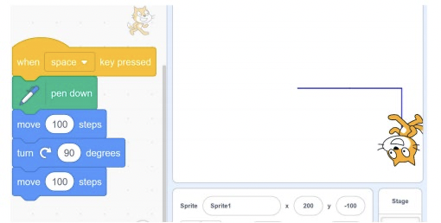
Module 5
Drawing angles
These degrees are divided between the numbers of corners a shape has:
Full rotation = 360 degrees
Square /rectangle = 4 x 90
Triangle = 3 x 120
Pentagon = 5 x 72
Hexagon=6x60

Slide 14
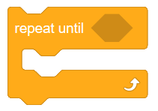
Module 5
Repeat until
Repeat Until () block is a Control block and a C block. Blocks inside this block will repeat until the specified statement or condition is performed. After that, the code beneath the C block (if any) will execute.

Slide 15
Experiment

Slide 16
Module 5
Angles
Make a sprite move in the following shapes; 1. A square 2. A circle 3. A hexagon 4. An octagon 5. A Flower
Notes:
Give them an example on each shape. Emphasis on the logic and help them explore other options.

Slide 17
Module 5
Design your own sprite!
Design your own sprite!
Draw your own sprite using the pen blocks.
Include:
1. Add a trigger (event)
2. Add the "Erase all"
3. Hide and show
4. Change color
Notes:
Make sure that the trainees add the following components:
Hide and Show
Change color
Erase

Slide 18
Module 5
Activity 3 : Feedback groups
When you are ready share your projects with a 'feedback group’.
A feedback group is a small group where each one shares their projects-in-progress with one another in order to get feedback and suggestions for further development.
Respond to the following questions:
What is something that could be improved?
What is something that could be done differently?
What is something that you really like about the project?
Tip:
take notes of the feedback and suggestions you get

Slide 19
Reflect

Slide 20
Module 5
Reflection
Questions
What was challenging about this coding club session?
What are you proud of?
What was the main feedback you got from your fellow coders?
What would you like to improve still?

Slide 21
Module 5
Additional Materials
Lesson Plan Module 5

