Slide 1
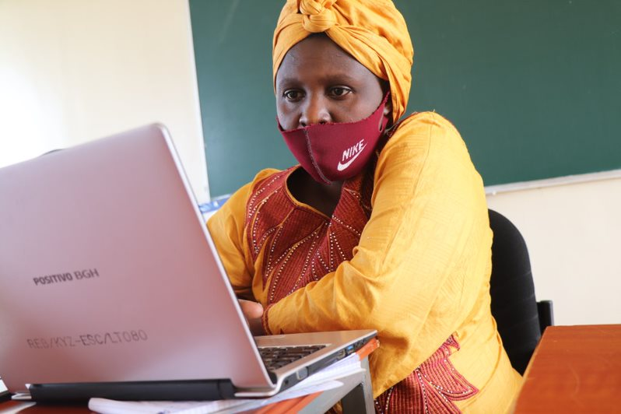
Scratch club sessions – Module 3 & 4

Slide 2
Stories & Animations

Slide 3
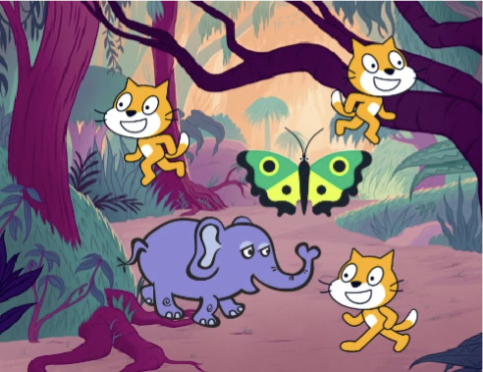
Module 3 & 4
Objectivies of module 3 & 4
Use
computational concepts in storytelling
Work
with different sprites
Animate
sprites and manage different backdrops in the same project.
Understand
the benefits of sensing blocks and control blocks
Understand
the importance of broadcasting
Explore
computational creation
Debug
the program that contains different blocks for a story.

Slide 4
Module 3 & 4
Introduction
Module 2 : Stories and Animations
Engage
What is your favorite animation movie?
Demonstrate
Working with different sprites
Communication between sprites
Sensing blocks
Control blocks
Broadcast blocks
Sound blocks
Experiment
Activity 1: Story with 10 blocks
Activity 2: Broadcasting
Activity 3: Animation video with at least 10 sprites
Activity 4: Feedback group
Reflect
Additional materials for Module 2

Slide 5
Engage

Slide 6
Module 3 - 4
What is your favorite movie?
What is your favorite animation movie?
What makes it a good movie?
What do your favorite movies have in common?
What characteristics make up an animation movie?
How are animation movies developed?

Slide 7
Demonstrate

Slide 8
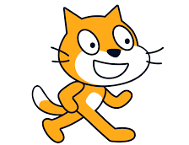
Module 3 & 4
Working with different sprites
The cat is the default character but you can change it.
You can combine images and sounds to make an interactive collage about your story.
https://youtu.be/CEuOFxPeFFY?list=PLeJNP8PdS1LvlJkMnHzMTx-C91EqMcHwO

Slide 9
Module 3 & 4
Communication between sprites
Broadcast command:
The command which makes two sprites communicate with each other is “Broadcast”. Broadcast is used to send a message

Slide 10
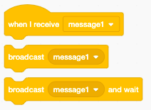
Module 2
Broadcast Blocks
Broadcasting is the process of making one sprite move to another sprite or send a message.
Broadcast () Block
Broadcast () and Wait Block
when I Receive () Block

Slide 11
Module 3 & 4
Try it out
Design a story related to the Covid-19 pandemic. The objective of this project is to motivate your learners to respect the hygiene regulations. The conversation below is an example.
Step 1: Student Mary greets student Peter. Nice to see you in a face mask.
Step 2: Mary asks Peter how he passed the covid19 Lockdown.
Step 3: They walk in school and the backdrop changes.
Step 4: Mary replies: “It was not good because I should have finished my S6”.
Step 5: Mary makes an apology with “sorry”.
Step 6: Peter also asks Mary: What about you?
Step 7: Mary replies “It was not too boring to me. Parents gave me a computer to learn online”.
Step 8: Peter replies “That’s good”.
Step 9: Mary asks Peter “Haven’t you recorded anything good during lockdown”?
Step 10: Peter replies “Washing hands several times and wearing a face mask is good for hygiene”.
Steps 11: Mary replies “Okay. Ooh you remind me to wash my hands and put my face mask.” Step 12: Mary replies “Let us go together to wash our hands”.
Working example: https://Scratch.mit.edu/projects/449741583/

Slide 12
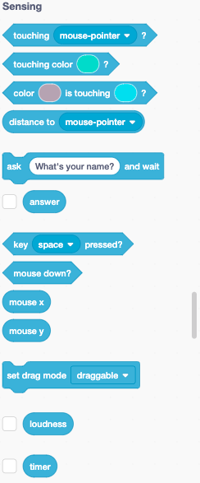
Module 3 & 4
Sensing blocks
Sensing blocks :
Touching block
Mouse down block
Follow the mouse pointer
Key is pressed
When 2 sprites collide
Asking a question
Try it out!
https://www.youtube.com/watch?list=PLeJNP8PdS1LvlJkMnHzMTx-C91EqMcHwO&v=fLZMGjL30Jk&feature=emb_imp_woyt

Slide 13
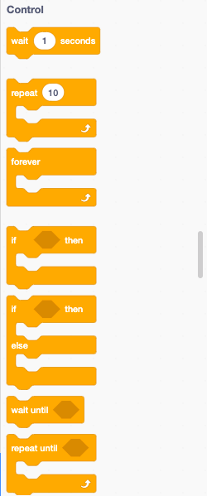
Module 2
Control blocks
Control blocks :
Wait
Repeat
Wait until ()
Repeat until
The "if" statement block
Forever loop
"Stop" block
"When I start as a clone" block
Create clone of () Block
Delete this clone

Slide 14
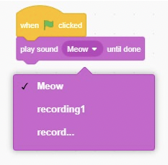
Module 3 & 4
Sound block
You may add sounds for animation purposes.
You may create your own sound through recording.

Slide 15
Module 3 & 4
Try it out
Create the following story, applying what you have learnt in this module. It is a discussion between Kamana and Kalisa. Use Scratch to create that discussion.
Kalisa: Kamana, where are you?
Kamana: I’ m in Kayonza centre (round about)
Kalisa: Aahhh Kamana would you join me for a talk?
Kamana: It’s Ok Mr Kalisa, where can I find you?
Kalisa: Kamana, assume that the road heading to Kigali is X –axis and the road heading to Kibungo is Y- axis, find me at point (-50, -50) coordinate at Cyeru cell nearby Kayonza district Headquarter
Kalisa: You mean I’ m at (0, 0) in coordinate system (Haaaa, Haaaa) it is now easy to find your location.
Kamana: Well, come find me at (-50, -50) then
Kalisa: Thank you Kamana for this orientation
If you are done with the exercise, use this link to compare your work.

Slide 16
Experiment

Slide 17
Module 3 & 4
Activity 1: Story with 10 blocks
Create a story with only these 10 Scratch blocks: go to, glide, say, show, hide, set size to, play sound until done, when this sprite clicked, wait, and repeat.
use each block at least once in ypur project and encourage them to experiment with different sprites, costumes, or backdrops
Test ideas by trying out different block combinations.
Mix and match blocks until you find something that interests you!
NB: Consult the lesson plan on module 2 for a detailed description of this activity.

Slide 18
Module 3 & 4
Activity 2: Broadcasting
Choose 2 sprites of your choice and a background reflecting two people meeting in an outside place. They are talking on how to develop a music project together. Program their dialogue using the ‘broadcast’ function.
Use costumes to change how your sprite looks.
Create different backdrops.
Try adding sound to your project.
Try adding movement
Notes:
Make sure that they complete all the tryouts on operators.

Slide 19
Module 3 & 4
Activity 3: Animation video
Create an animation video using at least 10 different sprites
Try brainstorming ideas with a neighbor!
Try sketching your story/ animation ideas on paper first
Experiment with different blocks and costumes until you find something you enjoy.
Need some inspiration? Find projects in the animation section of the Explore page.
Try adding sound to your project.
Consult the lesson plan on module 2 for a detailed description of this activity.

Slide 20
Module 3 & 4
Activity 4 : Feedback groups
When you are ready share your projects with a 'feedback group’.
A feedback group is a small group where each one shares their projects-in-progress with one another in order to get feedback and suggestions for further development.
Respond to the following questions:
What is something that doesn’t work or could be improved?
What is something that is confusing or could be done differently?
What is something that works well or you really like about the project?
Tip:
take notes of the feedback and suggestions you get

Slide 21
Reflect

Slide 22
Module 3 - 4
Reflection
Questions
What do you like the best about the project you made?
What did you learn?
What was the hardest part?
What would you like to improve still? Was the feedback group useful?
Was it difficult or easy to give/receive feedback? Why(not)?
What do you expect from this club?

Slide 23
Module 3 & 4
Additional Materials
Lesson Plan Module 2
Scratch Cards
Tutorials?

