Slide 1
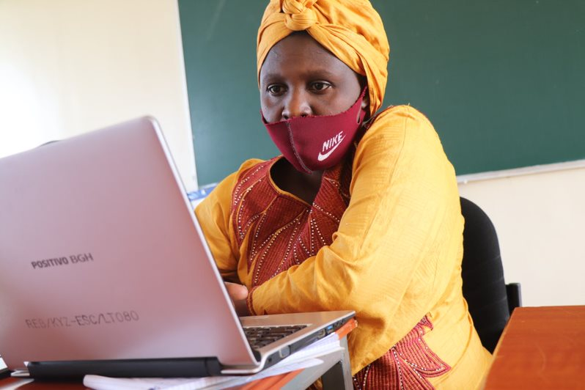
Scratch club sessions – Module 1 & 2

Slide 2
Module 1 & 2
Introduction
Module 1 : Contents
Engage
What is coding?
Linking coding to the world of work
Demonstrate
What is Scratch?
The Scratch Interface
Scratch Operators
Parallelism
Sequential execution of instructions
Stage Size
Geometry and pixels
Movement along the x axis and y axis
Experiment
Activity 1: Shoe robot (unplugged activity)
Activity 2: Scratch Cards Challenge
Activity 3: 30-minute Challenge
Reflect
Additional materials for Module 1

Slide 3
Engage

Slide 4
Module 1 & 2
What is coding?
Wordcloud - What is coding?
Name 3 keywords
NB: Consult the lesson plan on module 1 for a detailed description of this exercise.

Slide 5
Module 1 & 2
What is coding?
Instructions (codes)
Computer
Output
Coding is the art of instructing a computer of what to do.

Slide 6
Module 1
Programming Languages
2 categories of programming languages:
Frontend/client-side
Backend/sever-side

Slide 7
Module 1
Block/Text based languages
Block-based coding: instructions are mainly represented as blocks.
Text-based coding: instructions are oriented by text
Text based languages:
Python
Java
JavaScript
C
Block-based languages:
Scratch
Blockly
Elemental (still in development)
Notes:
Maybe too detailed for learners?

Slide 8
Module 1& 2
Linking coding to the world of work
What can you use coding for?
Name 3 things
NB: Consult the lesson plan on module 1 for a detailed description of this exercise.

Slide 9
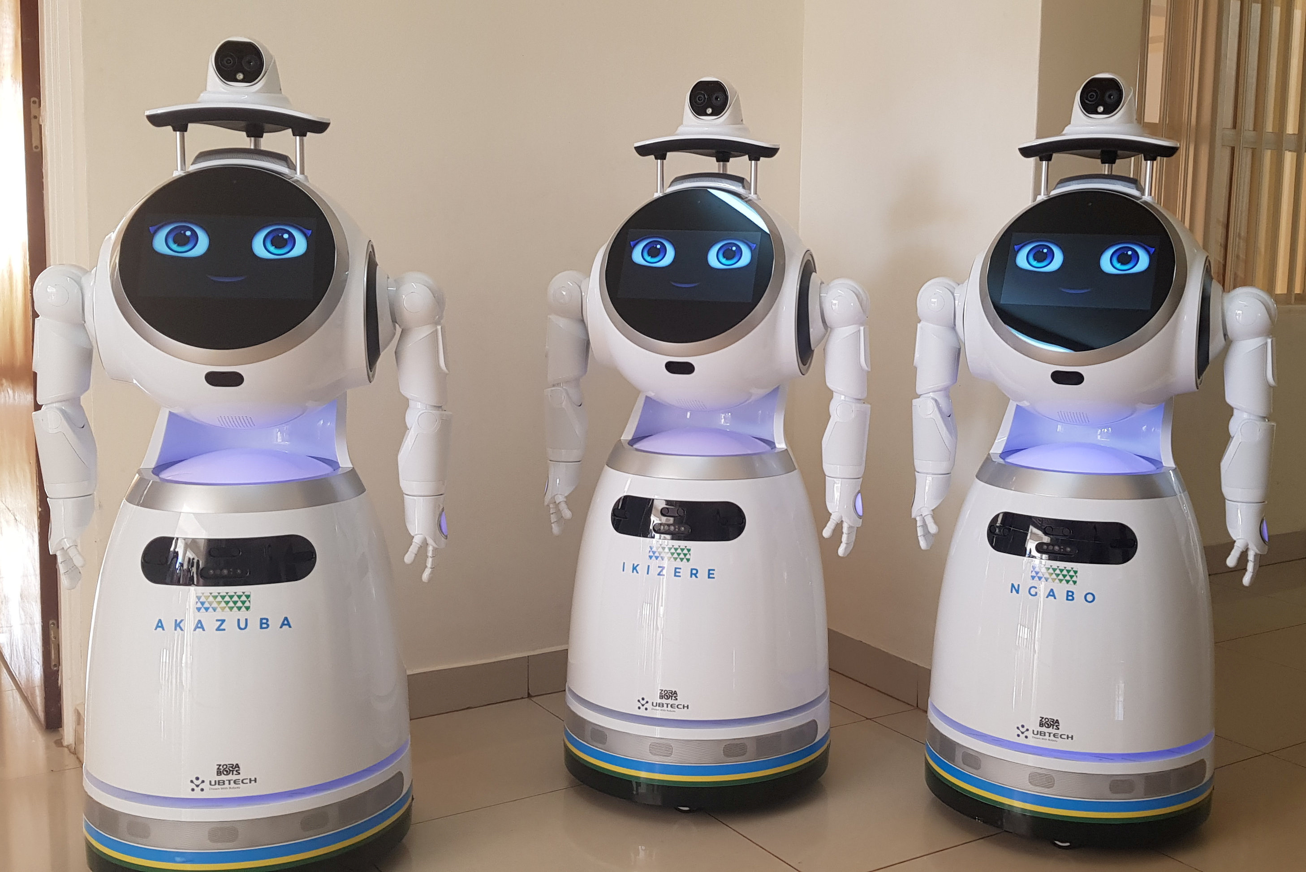
Module 1 & 2
Linking coding to the world of work
Example: ZoraBots Africa
https://www.youtube.com/watch?v=vsbI0skh1qM

Slide 10
Demonstrate

Slide 11
Module 1 & 2
What is Scratch?
It is a free programmable toolkit
It enables people to create their own games, animated stories, and interactive arts
It allows them to share their creations over the Internet.
Watch this intro video about Scratch: https://youtu.be/oJJdKZMaOTQ
Notes:
https://vimeo.com/29457909

Slide 12
Module 1 & 2
The Scratch interface
Complete quiz 1 on Moodle.

Slide 13
Module 1 & 2
Operators or ‘Blocks’
The Operators Block Palette contains 18 blocks. All these blocks have one thing in common: they take
one or more values and use them to return another value.
In programming, using values to produce other values is called performing an operation. The blocks that make operations possible are called “operators.” Operations are specific tasks that work with values to produce results.
EX: 1+3=4 or making a combination of words to form a sentence (e.g. “Hello” + “World” = “Hello World”).

Slide 14
Module 1 & 2
Operators or ‘blocks’
Some things they make possible include:
Keeping track of the score or result
Joining words to change what sprites say
Making sprites move in a realistic way
Solving math problems
Checking answers of a quiz
Randomizing the positions and movements of obstacles and monsters in a game
Try it out!
https://www.youtube.com/watch?v=yM6kpvmB7LM&feature=emb_imp_woyt

Slide 15
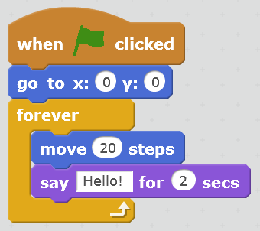
Module 1 & 2
Sequential execution of instructions
A Sprite is a flat image representing a character or object in your program. So far, sprite characters have stayed still. In this section, you will learn how to move around a Sprite and let it talk.
Try it out!
https://www.youtube.com/watch?v=VGc9EbeG57U&list=PLeJNP8PdS1LvlJkMnHzMTx-C91EqMcHwO

Slide 16
Module 1 & 2
Parallelism
Parallelism means getting two or more things happening at the same time. For example, what changes when you split a simple sequence into two programs executing in parallel?
Create a parallelism with 2 sprites.
Try it out: https://www.youtube.com/watch?list=PLeJNP8PdS1LvlJkMnHzMTx-C91EqMcHwO&v=IjC2rjRteY4&feature=emb_imp_woyt
Notes:
Read from page 65 – 67 in the pedagogical guide

Slide 17
Module 1 & 2
Try-Out
Activity: Conversation with a guest.
Perform the following instructions for a short conversation with a user.
Ask a user to enter his name whenever the sprite is clicked
Store the name in the answer block and my name variable and display both on the stage.
Great the person using the name entered for example.
Good morning Mary.
Create a variable adult age and set it to 18.
Ask the person his/her age and store the value in my age variable and display it on stage.
If the entered age is greater than 18, give this message
My name, you are an adult at my age.
Ex. Mary, you are an adult at 21.
If the entered age is less than 18, give this message
My name, you are young at my age.
Ex. Mary, you are young at 12.
Notes:
Read from page 65 – 67 in the pedagogical guide

Slide 18
Module 1 & 2
Stage size
The stage is where you see your stories, games, and animations come to life. Sprites move and interact with one another on the stage. The stage is 480 units wide and 360 units tall. It is divided into an x-y grid.
The screen is divided into X (horizontal) and Y (vertical) coordinates based on the centre of the stage which is at x-y coordinate (0, 0) and the numbers being positive or negative depending on their position.

Slide 19
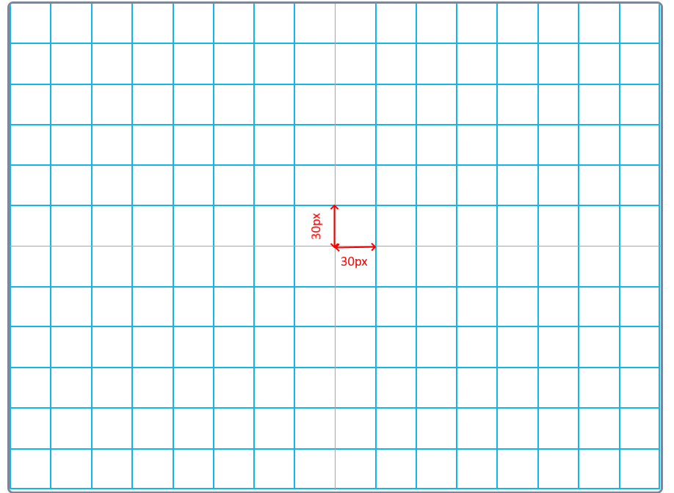
Module 1 & 2
Geometry and pixels
A computer screen or a picture is made up of tiny dots known as pixels. X and Y coordinates are respectively the horizontal (X) and vertical (Y) addresses of any pixel or addressable point on a computer display screen.

Slide 20
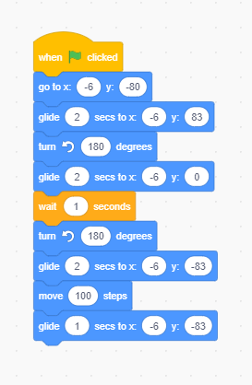
Module 1 & 2
Movement along the x axis and y axis
The motion blocks
The rotation blocks
The reporter block

Slide 21
Module 1
Try-Out
Activity: Using XY coordinates and the motion control palette, animate the locomotion of the following animals: Cheetah, penguin, duck, horse, donkey, gorilla, sheep, and cow.
Have a look at the example of the locomotion of the frog, man, bear, snake. Use the following instruction to move each animal.
Press b to move the bear
Press f to move the frog
Press m to move the man
Press s to move the snake
Locomotion link: https://Scratch.mit.edu/projects/449984077/
Notes:
Read from page 65 – 67 in the pedagogical guide

Slide 22
Experiment

Slide 23
Module 1 & 2
Activity 1 – The Shoe Robot (unplugged Activity)
Make the robot put on his/her shoe
Write down the instructions
One learner per group reads the instruction to the robot
What are the conclusions of this exercise?
NB: Consult the lesson plan on module 1 for a detailed description of the exercise.

Slide 24
Module 1 & 2
Activity 2 – Scratch Cards Challenge
Try out as many Scratch Cards as possible
Make groups (3-4 learners/group)
Take some Scratch cards or download them digitally
Try out as many cards as possible
NB: Consult the lesson plan on module 1 for a detailed description of this activity.

Slide 25
Module 1 & 2
Activity 3 – 30-minute Challenge
You have 30 minutes to make something surprising happen to a sprite
Create an account
Explore the projects in the library if you need ideas
Start creating something in 30 minutes
The goal of this activity is to establish a culture of fearlessness exploration and peer collaboration. It is expected that teachers will not know everything ahead of time, but we should create an environment where everyone learns together. Reflection questions:
How would you describe Scratch to a colleague?
- What kind of projects do you think learners will be motivated to create?

Slide 26
Reflect

Slide 27
Module 1 & 2
Reflection
Questions
What do you like the best about the project you made?
What did you learn?
What was the hardest part?
What would you like to improve still?
What do you expect from this club?

Slide 28
Module 1 & 2
Additional Materials
Lesson Plan Module 1
Scratch Cards

