Slide 1
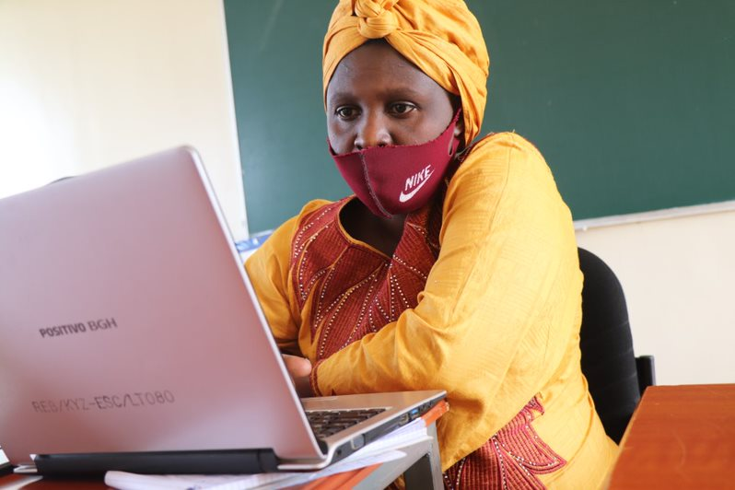
Scratc²h 2050 Project

Slide 2
Module 0
Why code?
The objectives:
Develop the concept of computational creation through Scratch.
Use different concepts and features of Scratch.
Develop games, stories, and animations with Scratch.
Develop communication, critical thinking, problem solving, collaboration, and creativity skills.
Develop an interest in ICT and coding.
Understand the link between coding and the world of work.

Slide 3
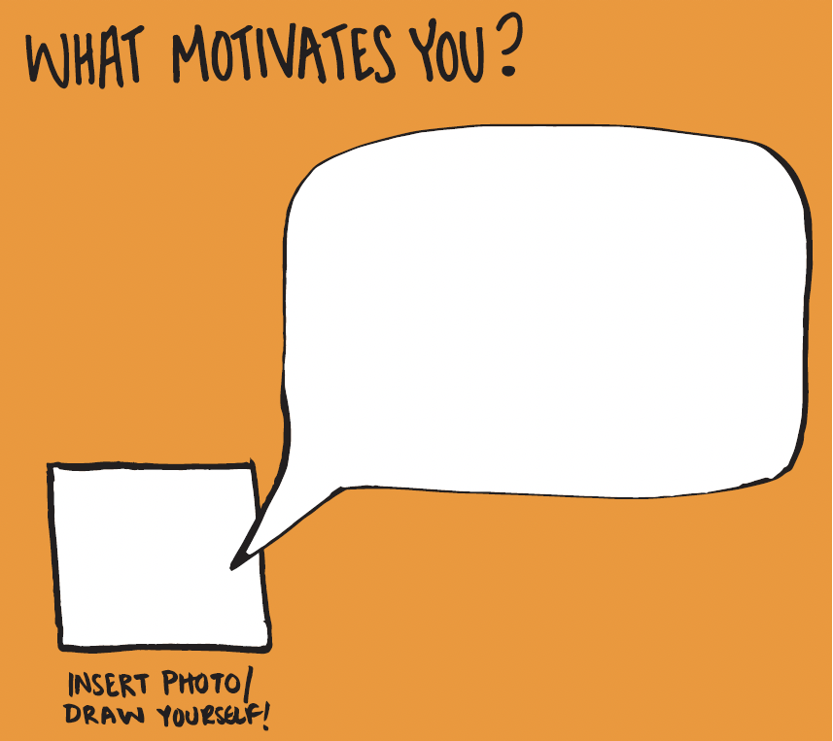
Module 0
Introduce yourself
Your name and grade
What motivates you?
What do you expect from this coding club?

Slide 4
Module 0
What is a coding club?
What is a coding club?
“Coding clubs are communities of students that meet regularly after school to learn and exchange knowledge on Scratch.”
The coding club is not a lesson. The purpose is to learn together about coding and work on fun coding projects.
Coding skills are important life skills. Many interesting jobs require ICT skills and coding competences.
Everyone is welcome to join the club. You do not need to have advanced ICT skills. Motivation is most important.

Slide 5
Module 0
Principles
Programming is not taught by teachers on blackboards. Programmers teach themselves.
Programming is not learned by reading theory, but writing code/ moving blocks and understanding why it works or not.
Programming is a collaborative effort. So is learning it.
https://scratch.mit.edu/projects/124863501/

Slide 6
Module 0
Coding Club Goals
What do you want to achieve after 12 weeks of coding?
Write at least 3 things down
Complete this sentence: “After 12 weeks of coding I want to know/have/learned/understand/make…”
We will write our most common goals on a big poster

Slide 7
Module 0
Where and When?
When and where will the coding club take place?

Slide 8
Module 0
Representative
Who will be the representative of the coding club?
Tasks
facilitate the communication between club members and teachers.
help in organising club activities

Slide 9
Module 0
Club rules
In two groups, brainstorm for rules that will allow the club to function well.
Examples:
Be on time
Be gentle with the computers
Complete this sentence: “In order for our coding club to function well we all…”
We will write our most common rules on a big poster

Slide 10
Module 1
Coding Club Structure
Structure
Engage
Introduction of the topic of the day and share some ideas
Demonstrate
Demonstrate the first few steps so you can see how to get started
Experiment
Time (individually or in group) to create your own projects
Reflect
At the end of the session, we share our projects and reflect

Slide 11
Let`s Code!

